Slide 1



Reasoning for IR & IR for Reasoning
SIGIR 2026 Tutorial
Mohanna Hoveyda | Panagiotis Eustratiadis | Arjen P. de Vries | Maarten de Rijke
https://reasoning-for-ir.github.io/
July 20, 2026

Slide 2




Presenters
Mohanna Hoveyda
Panagiotis Eustratiadis
PhD Student Radboud University
Postdoc
UvA
Bloomberg
Arjen P. de Vries
Maarten de Rijke
Professor Radboud University
Co-Founder Spinque
Professor
UvA
Scientific Director
ICAI
Notes:
bloomberg

Slide 3

Goal for today
Reasoning & IR;
Challenges, the methods landscape, and open research areas
Part II:
Generative
Reasoning
Part IV:
Neuro-Symbolic & Structured Reasoning
Research Gaps & Opportunities
Introduction
Part I:
Reasoning in IR; Definition & Challenges
Part III:
Teaching Retrievers to Reason
Part V:
Reasoning Under Uncertainty
30 min break at 15:00

Slide 4
Introduction
Why is reasoning is central to IR?
Complex information needs
The large landscape of methodologies

Slide 5
Why is reasoning central to information retrieval?
Increasingly complex queries
Scattered & incomplete information
Limitations of existing solutions
Compositional, multi-step, temporal, causal, …
Issued by both humans and
search agents
Relevance often depends on several documents
Incomplete information at hand while answering user questions
Evidence might change over time
Embeddings limited in representing constraints & dependencies
LLMs can produce plausible yet wrong traces and references
Scaling reasoning-capable solutions to millions of documents is expensive and inefficient
Notes:
Motivation slide
Treatments for migraine that don't cause drowsiness and are safe to combine with blood thinners

Slide 6
Complex Queries issued by user/agent
Round 1
Query:
“efficient transformers”
Many results hits: surveys, blogs, many transformer architectures.
Too broad — topic alone doesn't define the need.
Round 2
Query:
+ “for long documents”
Better but results are dominated by sparse-attention models the user can't deploy.
A hidden constraint surfaces only AFTER seeing results.
Round 3
Query:
+ “don't use sparse attention”
Worse! Matching now retrieves MORE sparse-attention papers.
Out of the box retrievers match semantic similarity, not constraints
Round 4
Query:
+ “validated across multiple domains”
A search agent compiles the whole session into one query…

Slide 7


Final issued query:
Efficient transformers for long documents that don’t use sparse attention, that are validated across multiple domains

Slide 8

Efficient transformers

Slide 9

Efficient transformers for long documents

Slide 10
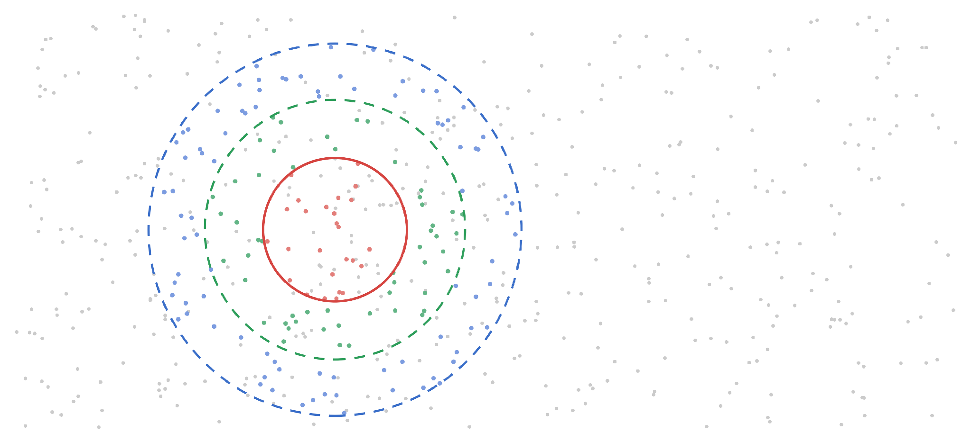
Efficient transformers for long documents that don’t use sparse attention,
Complex query

Slide 11
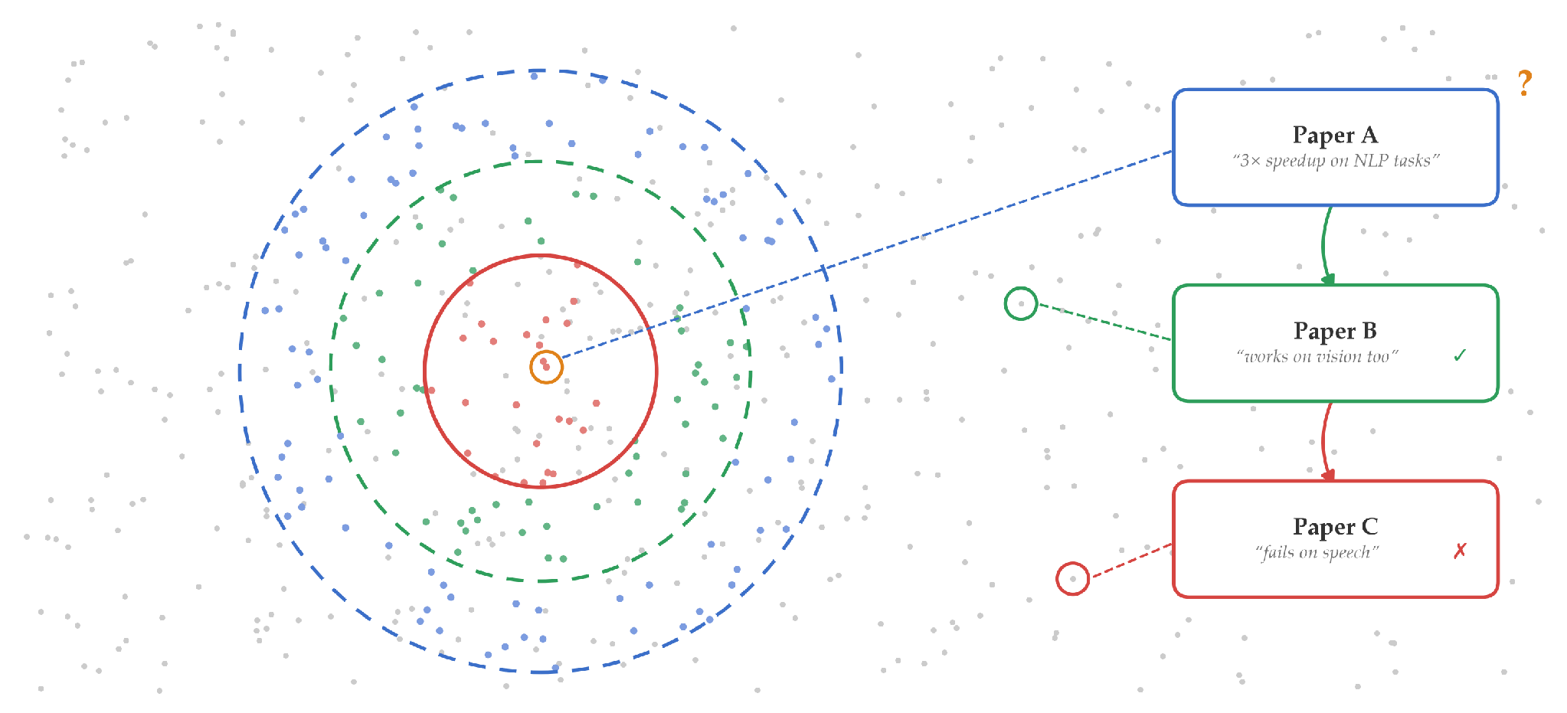
Efficient transformers for long documents that don’t use sparse attention, that are validated across multiple domains
Inference goes beyond similarity matching…
Complex query | Scattered & incomplete information | Limitations of existing solutions
The evidence is not in A, but in B and C.

Slide 12
The methods landscape
LLMs
Retrievers
Neuro-
Symbolic and Structured Reasoning
Test-Time Reasoning
RL-training for better LRMs and Deep Research Agents
Lexical/Semantic Similarity
Reasoning Enhanced training data
Probabilistic Reasoning and Modelling Uncertainty
Multi-agent/component collaboration
Enhanced Representation/Embedding Space

Slide 13
In this tutorial, we will cover…
A working definition of reasoning in the context of IR
An analytical framework built on three axes
Representational Capability: Can the representation encode the required information for reasoning, i.e., uncertainty, causality, logical constraints?
Inference Faithfulness: Can we verify that the reasoning process is faithful?
Computational Feasibility for IR: Is it feasible at retrieval scale?
Current methodologies
LLM-based: inference time reasoning, and RL-enhanced LRMs
Beyond LLMs: Neuro-symbolic, probabilistic/Bayesian frameworks, enhanced representation
Bridging & future directions
Comparative analysis of paradigms along the three axes, open challenges, and research opportunities

Slide 14
Key takeaways for the audience
→ Familiarity with the key methods and their trade-offs
→ A structured lens for reasoning for IR approaches
→ Open research questions
All tutorial slides and reading list are/will be available at: https://reasoning-for-ir.github.io/
Throughout the tutorial:
Ask questions anytime!
(+5 minutes Q&A in 1st and 2nd half)

Slide 15
Reasoning:
Definition & challenges in IR
Notes:
#section: Reasoning: Definition & challenges in IR | 30

Slide 16
Roadmap for Part 2
2.1 The reasoning demands of IR
What complex tasks actually require • The multi-step argument • Open questions
2.2 What LLMs have been shown to do
Algorithmic approaches • Critical findings paired • BRIGHT as diagnostic • Additional resources
2.3 What reasoning actually is
Definitional problem • Philosophical traditions • 12-type taxonomy
2.4 Implications, open problems, takeaways
Evaluation design • System design • The normative gap • Reasoning axes

Slide 17
1. The reasoning demands of IR
Notes:
#section: Reasoning: Definition & challenges in IR | 30

Slide 18
What IR tasks actually require
Navigational
“Find this specific paper”
Retrieval suffices
Comparative synthesis
“How do methods A & B compare in low-data regimes?”
Answer must be constructed
Evidence quality
“What is the state of evidence on X?”
Evaluate, weight, conflict-resolve
Gap identification
“What aspects of X are understudied?”
Reason about absence, not retrievable
retrieval-sufficient
reasoning-constitutive

Slide 19
The structural argument for multi-step reasoning
The basic argument
Some information needs cannot be satisfied by any single document. When retrieval steps are sequentially dependent, each conditioned on prior results, multi-step reasoning is the necessary mechanism.
The relevance structure argument
Relevance for reasoning-intensive queries is not a two-place relation (document, query) but a relational structure across a document set. A document can become relevant in context of established premises. Standard retrieval, computing relevance document-by-document, structurally cannot handle this.
The knowledge network argument
Research knowledge is a network of inferential, evidential, and conceptual dependencies, not a flat collection. Retrieval samples nodes near the query; reasoning traverses inferential edges. Multi-step reasoning is the endpoint of a trajectory the field has followed since pseudo-relevance feedback.

Slide 20
The governing question
Multi-step reasoning is what complex IR requires
Do current LLM-based systems actually provide it? And how would we know?
Complication 1
Multi-step reasoning is not always warranted. For navigational and simple factoid queries, it adds cost and failure modes without benefit. Detecting when it is needed is itself a non-trivial reasoning problem.
Complication 2
Whether LLMs actually perform multi-step reasoning, rather than simulating its surface form through pattern completion, is empirically open. BRIGHT and GSM-Symbolic give early evidence the gap is substantial.

Slide 21
2. What LLMs have been shown to do
Notes:
#section: Reasoning: Definition & challenges in IR | 30

Slide 22
Algorithmic approaches to LLM reasoning
Chain-of-thought Wei et al., 2022
Addresses: Step-chaining in deductive & arithmetic tasks
Self-consistency Wang et al., 2023
Addresses: Sampling multiple path; majority-vote aggregation
Least-to-most/Tree of thoughts Zhou et al., 2023; Yao et al., 2023
Addresses: Compositional decomposition; search over reasoning
Process reward models Lightman et al., 2023
Addresses: Step-level evaluation, not outcome-only
Inference scaling (o1/R1) OpenAI 2024; DeepSeek 2025
Addresses: Test-time compute trading for reasoning quality

Slide 23
Critical findings paired with capability claims (1/2)
Capability claim
Critical finding
CoT improves performance on GSM8K multi-step arithmetic substantially (Wei et al. 2022)
GSM-Symbolic (Mirzadeh et al. 2025): performance is token-sensitive and surface-fragile. Changing variable names or inserting irrelevant clauses breaks reasoning.
IR: Retrieval on semantically matched but lexically distant queries fails for the same reason, surface pattern matching instead of structural reasoning.
Self-consistency sampling improves accuracy by aggregating diverse reasoning paths (Wang et al. 2023)
Faith & Fate (Dziri et al. 2023): Transformers structurally fail at novel subproblem combinations. Performance reflects training subgraph statistics.
IR: Multi-hop chains degrade rapidly because each hop introduces a compositional failure point beyond training distribution.
Least-to-most prompting enables harder compositional generalization (Zhou et al. 2023)
Compositionality failures persist even with explicit decomposition when composed subproblems are out-of-distribution (Dziri et al.).
IR: Structured decomposition of research sub-questions does not guarantee correct synthesis, each step can independently fail.

Slide 24
Critical findings paired with capability claims (2/2)
Capability claim
Critical finding
RAG improves factual grounding by injecting retrieved documents into the generation context
GSM-IC (Shi et al. 2023) and Lost in the Middle (Liu et al. 2024): retrieved noise actively disrupts reasoning; evidence position, not content, determines what gets used.
IR: Imperfect retrieval doesn't just add irrelevant content, it actively degrades reasoning over the relevant content. Position bias means document ordering affects conclusions.
Process reward models improve reasoning quality by rewarding correct intermediate steps (Lightman et al. 2023)
Chen et al., (2025)’s faithfulness study: reasoning traces are not faithful to internal computation. The visible CoT and the actual causal process are partially decoupled.
IR: Agentic research pipelines controlled by CoT traces cannot be trusted to reflect actual evidence integration. The logged trace may be misleading about what drove the conclusion.
Inference scaling (o1/R1) produces strong performance on math, coding, and science benchmarks
Schaeffer et al. 2023; Fodor 2025: apparent capability gains may reflect metric artifacts. GSM1K (Zhang et al.) shows leakage causing several-point drops.
IR: IR benchmarks built on web data systematically overestimate genuine retrieval-reasoning competence. Benchmark saturation ≠ task competence.

Slide 25
BRIGHT: The IR-specific diagnostic
What BRIGHT brings
Real-world queries from diverse domains requiring in-depth reasoning to identify relevant documents beyond surface form matching. Not keyword retrieval, but inferential retrieval.
“The leading model on the MTEB leaderboard SFR-Embedding-Mistra, which achieves a score of 59.0 nDCG@10,1 produces a score of nDCG@10 of 18.3 on BRIGHT. We show that incorporating explicit reasoning about the query improves retrieval performance by up to 12.2 points.”
(Su et al., 2025)
The interpretation
The performance collapse is not retrieval failure, it is reasoning failure. Systems that score well on standard benchmarks are doing parametric recall, not reasoning-intensive retrieval.
The evaluation philosophy
Leakage-resistant, reasoning-intensive, out-of-distribution. This is the evaluation model the tutorial advocates. BRIGHT is a proof-of-concept, not a final solution.

Slide 26
Diagnostic resources besides BRIGHT
Benchmark | Constraint type | Explicitness | Corpus | Evaluation unit | Reference
NevIR | Negation | Implicit in documents | Derived from CondaQA | Pairwise ranking flip | Weller et al., 2024
ExcluIR | Exclusion (“not X”) | Explicit in query | MS MARCO-Style | nDCG@10 | Zhang et al., 2024
QUEST | Set operations | Implicit in query | Wikipedia entities | Recall@k, F1 | Malaviya et al., 2023
CondaQA | Negation implications | Passage-level | Wikipedia | Reading comprehension | Ravichandat et., 2022
NegBench | Negation understanding | Explicit | Multi-modal | Accuracy, recall | Alhamoud et al., 2025
FollowIR | Arbitrary instructions | Explicit narrative | TREC collections | Pairwise instruction-sensitivity | Weller et al., 2025
BIRCO | Multi-faceted objectives | Explicit | Mixed | nDCG | Wang et al., 2024
BRIGHT | Inferential relevance | Implicit | Domain corpora | nDCG@10 | Su et al., 2025
Starting point
Negation understanding
Instruction-following
Multi-constraint retrieval
Reasoning-intensive retrieval

Slide 27
3. What reasoning actually is
Notes:
#section: Reasoning: Definition & challenges in IR | 30

Slide 28
The definitional problem
The LLM field uses at least six mutually inconsistent implicit definitions of “reasoning”
1 Correct task performance
Benchmark papers (GSM8K, MMLU, BIG-Bench Hard)
4 Faithful intermediate process
CoT, Process Reward Models (Lightman et al.)
2 Robustness to surface transformations
GSM-Symbolic, GSM-IC (Mirzadeh et al. / Shi et al.)
5 Out-of-distribution generalization
GSM-Symbolic, GSM-IC (Mirzadeh et al. / Shi et al.)
3 Compositional generalization
Faith and Fate (Dziri et al.)
6 Grounded understanding
Stochastic Parrots (Bender et al. / Madabushi et al.)

Slide 29
Five philosophical traditions – IR translations
Aristotle
Form-content separation
Behavior governed by logical structure, not surface tokens → the GSM-Symbolic test
Kant
Systematic unity vs. local judgment
Answering queries correctly ≠ integrating a literature coherently → the research synthesis gap
Frege
Normative, not descriptive
Correct output ≠ valid inference; distinguishes LLM performance from logical competence
Wittgenstein
Rule-following underdetermination
High benchmark scores don't reveal which rule is followed, GSM-Symbolic shows the wrong rule
Peirce
Deduction/Induction/Abduction
Only deduction is tested; abduction (hypothesis formation, query intent) is almost entirely absent

Slide 30
A 12-type taxonomy, with evaluation coverage
Reasoning type | IR manifestation | Coverage
Deductive | Logical entailment between query and document | Partial
Inductive | Generalizing from retrieved evidence to claims | Partial
Abductive | Query intent inference; hypothesis formation from evidence | Untested
Analogical | Cross-domain retrieval; structural relevance beyond surface | Untested
Causal | Distinguishing correlation from intervention evidence | Untested
Defeasible | Provisional relevance; belief revision on new retrieval | Untested
Modal | Tracking claim strength (established/contested/speculative) | Untested
Epistemic | Knowledge state tracking across a literature over time | Untested
Dialectical | Mapping argumentative position within a field's disputes | Untested
Temporal | Evidence currency; supersession; historical state tracking | Partial
Metacognitive | Query reformulation; knowing when to stop; uncertainty flag | Partial
Practical | Search strategy decisions in agentic pipelines | Untested
Notes:
Symbolic vs probabilistic @Maarten

Slide 31
4. Implications, open problems, takeaways
Notes:
#section: Reasoning: Definition & challenges in IR | 30

Slide 32
Evaluation design
A credible evaluation of reasoning-intensive IR must be:
Leakage resistant
Queries from sources unlikely to appear in training data: recent publications, proprietary datasets, template-generated novel surface forms.
Reasoning-type stratified
Separate tracks for different reasoning types. Aggregate scores conceal type-specific failures. Use the 12-type taxonomy as the stratification grid.
Multi-hop with verified structure
Not just questions that happen to require multiple documents, hop structure explicitly annotated so each hop is independently evaluable.
Faithful trace evaluation
For agentic systems: evaluate not just final answers but whether the reasoning trace causally accounts for the answer, not just post-hoc rationalization.
IR already has evaluation tradition and infrastructure. Now design the right tasks

Slide 33
System design implications
Each failure mode implies a design response, presented as hypotheses, not solutions:
Surface fragility
→
Retrieval augmented with formal semantic representations abstracting over surface form
Compositional failure
→
Explicit subproblem decomposition with intermediate verification and backtracking
Noise sensitivity
→
Retrieved document filtration before reasoning, not after; confidence-weighted aggregation
Position bias
→
Retrieval-order-invariant aggregation; multiple orderings with consistency checking
Unfaithful traces
→
Separate search-control logic from generation; formal verification of intermediate steps
Missing reasoning types
→
Specialized modules for causal, defeasible, dialectical reasoning not in base LLM

Slide 34
The normative gap
Current evaluation
Behavioral criterion
Does the system produce correct outputs?
Performance tested on distribution close to training data. Benchmark saturation is taken as evidence of competence.
What research requires
Normative sensitivity
Is the system responding to the quality of reasons
Weight a randomized controlled trial over an observational study not because RCTs appear more in training, but because they provide stronger causal evidence.
Three open questions
1. Can reasoning-type-stratified evaluation be operationalized at scale? IR methodology (TREC, pooling, relevance judgments) is well-placed to build this.
2. Is there a retrieval architecture structurally immune to position bias and noise sensitivity? Or are these failures fundamental to transformer attention?
3. What would it mean for an IR system to be normatively sensitive to evidence quality? Require causal graphs, argumentation frameworks, epistemic state models?

Slide 35
Three helpful “reasoning axes”
To help compare and relate reasoning proposals in different contexts
Representational capability
E.g., Does reasoning proposals explicitly encode uncertainty, causal relationships, etc.?
Representational capability
Inference faithfulness
Can faithfulness of the reasoning process be verified?
Computational feasibility for IR
Is the reasoning process computationally feasible over a large set of documents?
Inference faithfulness
Computational feasibility for IR

Slide 36
Wrapping up Part 2
1 Complex information needs require multi-step reasoning across documents, following inferential edges in the knowledge network, not sampling surface-similar nodes
2 The empirical question is whether LLM-based systems provide this; evidence suggests they approximate it on familiar distributions but fail on robustness, compositionality, noise resistance, faithful integration, and evidence quality
3 The conceptual framework needed to evaluate this properly, a 12-type taxonomy, normative rather than behavioral criteria, definitional precision, is available in the philosophical literature but not yet imported into IR
4 The research agenda is to import it: build leakage-resistant, reasoning-type-stratified evaluation; design architectures that address specific failure modes; and close the normative gap, using the reasoning axes to help organize material

Slide 37
II. Generative Reasoning:
From Chain-of-Thought to Multi-Agent Systems
Notes:
#section: Methods (I): LLM-based | 45

Slide 38
1. Why LLMs for reasoning?
Notes:
#section: Reasoning: Definition & challenges in IR | 30

Slide 39
Transformer
and its limitation for sequential reasoning

Slide 40
Transformer
and its limitation for sequential reasoning
Efficient transformers
for long documents
that don’t use sparse attention,
and are validated across multiple domains
Answering a query requires sequential reasoning;

Slide 41
Transformer
and its limitation for sequential reasoning
Efficient transformers
for long documents
that don’t use sparse attention,
and are validated across multiple domains
Answering a query requires sequential reasoning;
Make a move;
e.g., decompose a query, retrieve candidates/evidence, check constraints. etc.

Slide 42
Transformer
and its limitation for sequential reasoning
Efficient transformers
for long documents
that don’t use sparse attention,
and are validated across multiple domains
Answering a query requires sequential reasoning;
Make a move;
e.g., decompose a query, retrieve candidates/evidence, check constraints. etc.
The partial answer;
Valid? Continue. Not valid? Backtrack and try another branch.

Slide 43

Transformer
and its limitation for sequential reasoning
Efficient transformers
for long documents
that don’t use sparse attention,
and are validated across multiple domains
Answering a query requires sequential reasoning;
Make a move;
e.g., decompose a query, retrieve candidates/evidence, check constraints. etc.
The partial answer;
Valid? Continue. Not valid? Backtrack and try another branch.
…
This naturally unfolds as a tree;
Each node, depends on its parents.
Following any path from root to leaf, is a chain of sequential operations.

Slide 44
Transformer
and its limitation for sequential reasoning
Transformers, however, can only represent a chain of limited depth.
T Layers
…
Depth (L)
N Tokens

Slide 45
Transformer
and its limitation for sequential reasoning
Transformers, however, can only represent a chain of limited depth.
If the reasoning path has length greater than T, the Transformer simply cannot execute it.
T Layers
…
Depth (L)
N Tokens
L > T
We need recurrence to unfold computations over time for as many steps as needed.
Notes:
Conceptually, a Transformer lays out its computations in two dimensions. It applies a fixed stack of T layers sequentially, and within each layer, it processes all N tokens in parallel.
This parallelism is powerful, but it does not help with problems that require strictly sequential reasoning. Each computational node in the path must happen on its own layer, since it cannot be computed in parallel with its parent.
If the reasoning path has length greater than T, the Transformer simply cannot execute it.
What is missing is recurrence.

Slide 46
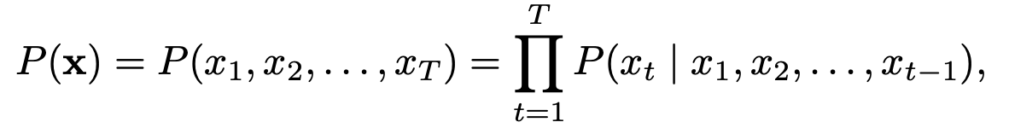
Then, why LLMs became so popular for reasoning?
In practice, autoregressive generation enables recurrence.
Researchers recognized this looping behaviour as a proxy for sequential reasoning (Wei et al., NIPS 2022).
Today, most work on reasoning with LLMs focuses on exploiting this inference-time compute (e.g., O1, DeepSeek)
Autoregressive Language Model

Slide 47
2. Rise of inference-time approaches
Notes:
#section: Reasoning: Definition & challenges in IR | 30

Slide 48
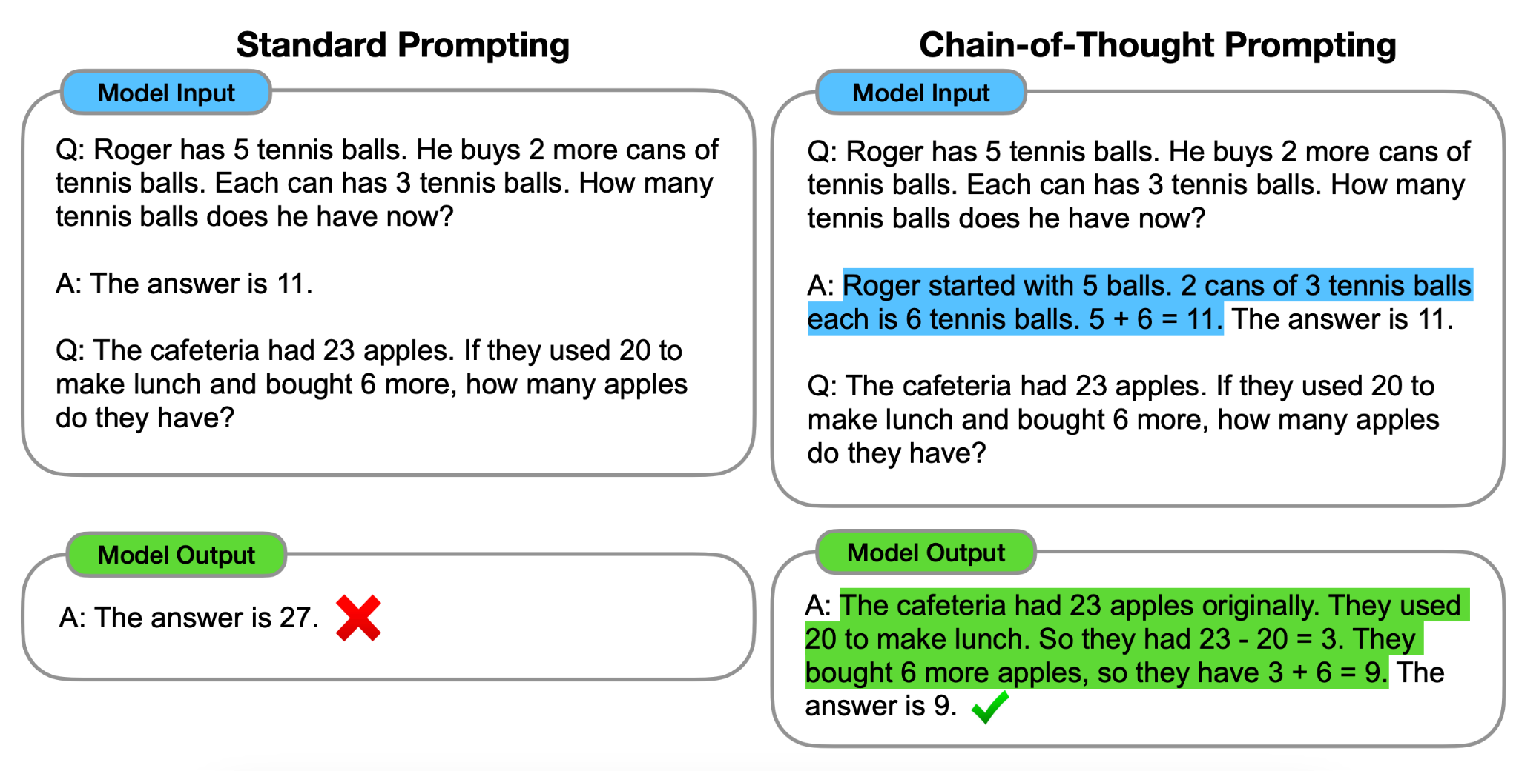
Chain-of-Thought
(Wei et al., 2022)
Definition:
Generating a series of intermediate reasoning steps to solve a given problem.
Notes:
The core idea behind chain-of-thought prompting is to provide a large language model with a few demonstrations of a "chain of thought"
CoT: a coherent series of intermediate natural language reasoning steps that lead to the final output
Designed to mimic the human thought process of decomposing complicated, multi-step problems into intermediate steps and solving each one before arriving at a final answer
It is implemented simply by including a few examples of <input, chain of thought, output> triples in the model's prompt
Motivation: 1) In-context few-shot prompting: Large language models have shown they can learn tasks simply by being prompted with a few input-output 2) Natural language rationales: Prior research demonstrated that models performing arithmetic reasoning benefit from generating intermediate natural language steps
Advantages CoT:
Improves complex reasoning
Interpretability and debugging: Generating intermediate steps provides an interpretable window into the model's behavior
By decomposing multi-step problems, the model learn to can spend more computation on problems that require harder reasoning
Simplicity and efficiency: It unlocks powerful reasoning capabilities in off-the-shelf models simply by providing a few examples
Broad applicability: Because it relies on natural language, the method is versatile and potentially applicable to any task that humans solve via language
Limitations:
Requires massive model scale: meaning it generally only improves performance on models with roughly 100 billion parameters or more
High deployment costs: Because it relies on very large language models to function effectively, it is costly to serve in real-world applications
When applied to smaller models, it often produces fluent but illogical reasoning, which can actually result in worse performance than standard prompting
No guarantee of correctness: The generated reasoning paths are not guaranteed to be factual or logically sound
Models can still make semantic errors, miss steps, or arrive at the correct final answer through entirely flawed logic or coincidence
Illusion of reasoning: Although the method successfully mimics human step-by-step thinking, it remains an open question whether the neural network is actually "reasoning"
Sensitivity to prompt engineering: While generally robust, the model's performance can still vary depending on the linguistic style of the annotator, the order of the examples, or how the prompt is crafted, with some complex tasks requiring highly specific prompt engineering to succeed

Slide 49
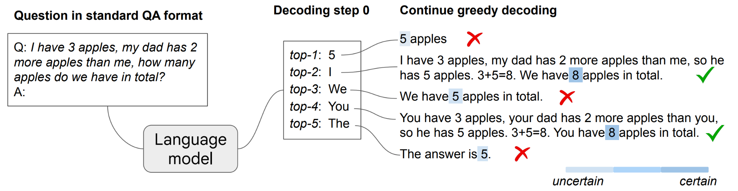
CoT Reasoning Without Prompting
(Wang & Zhou, 2024)
Wang, Xuezhi, and Denny Zhou. "Chain-of-thought reasoning without prompting." NeurIPS 2024
Notes:
The main idea behind CoT reasoning without prompting is to assess a language model's intrinsic reasoning abilities without the influence of human priors introduced by specific prompting techniques
Observation: pre-trained LLMs naturally possess inherent reasoning capabilities that are simply obscured by standard decoding methods
How: alter the decoding procedure by exploring alternative top−k tokens at the first decoding step instead of relying solely on the top-1 greedy path
When branching out to these alternative starting tokens, CoT reasoning patterns naturally emerge within the model's decoding trajectories
To reliably identify the correct reasoning path among these variations → CoT-decoding, which relies on the model's own confidence levels: when a CoT reasoning path is present, the model demonstrates significantly higher confidence in its final decoded answer

Slide 50
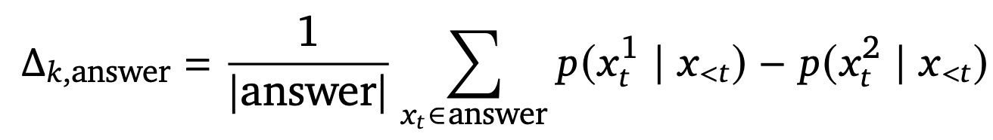
CoT Reasoning Without Prompting
(Wang & Zhou, 2024)
CoT decoding:
branch at the first token into top-k,
decode each greedily,
then select the path with
the highest answer confidence
Wang, Xuezhi, and Denny Zhou. "Chain-of-thought reasoning without prompting." NeurIPS 2024
Notes:
This confidence is calculated by measuring the probability disparity between the top and secondary tokens when the model outputs its final answer.
By generating the top−k paths and selecting the one with the highest answer confidence, CoT-decoding effectively isolates the most reliable reasoning path without requiring any task-specific prompts or model tuning
Answer confidence serves as a reliable filter to identify the correct CoT path because language models naturally demonstrate significantly higher certainty in their final answer when a CoT reasoning process precedes it
= branch at the first token into top-k, decode each greedily, then select (or weight-aggregate) the path with the highest answer confidence Δ

Slide 51
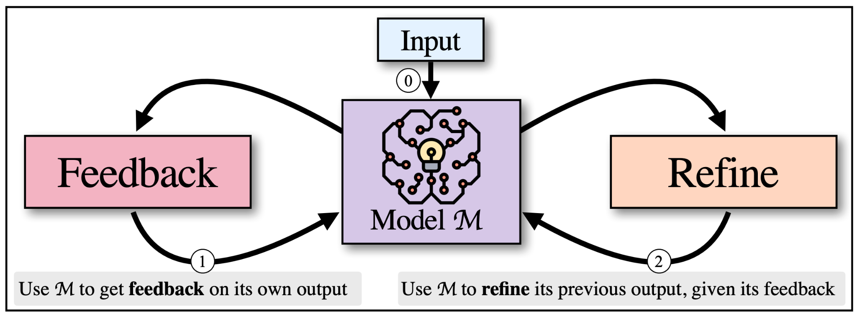
Self-refine
(Madaan, et al., 2023)
Madaan, et al. "Self-refine: Iterative refinement with self-feedback." NeurIPS 2023
Notes:
Motivation: much like humans, LLMs do not always generate the best possible output on their first attempt
In human problem-solving, individuals naturally use iterative self-refinement (they create an initial draft, reflect on it to provide self-feedback, and then revise it to improve quality, such as rewriting an email to sound more polite)
The algorithm works by alternating between generative steps:
Initial Generation: The model creates a first draft based on the user's input
FEEDBACK: The same model reviews its own output and is prompted to generate specific, actionable feedback on how to improve it
REFINE: The model is then fed its own feedback and uses it to revise and improve the previous draft

Slide 52
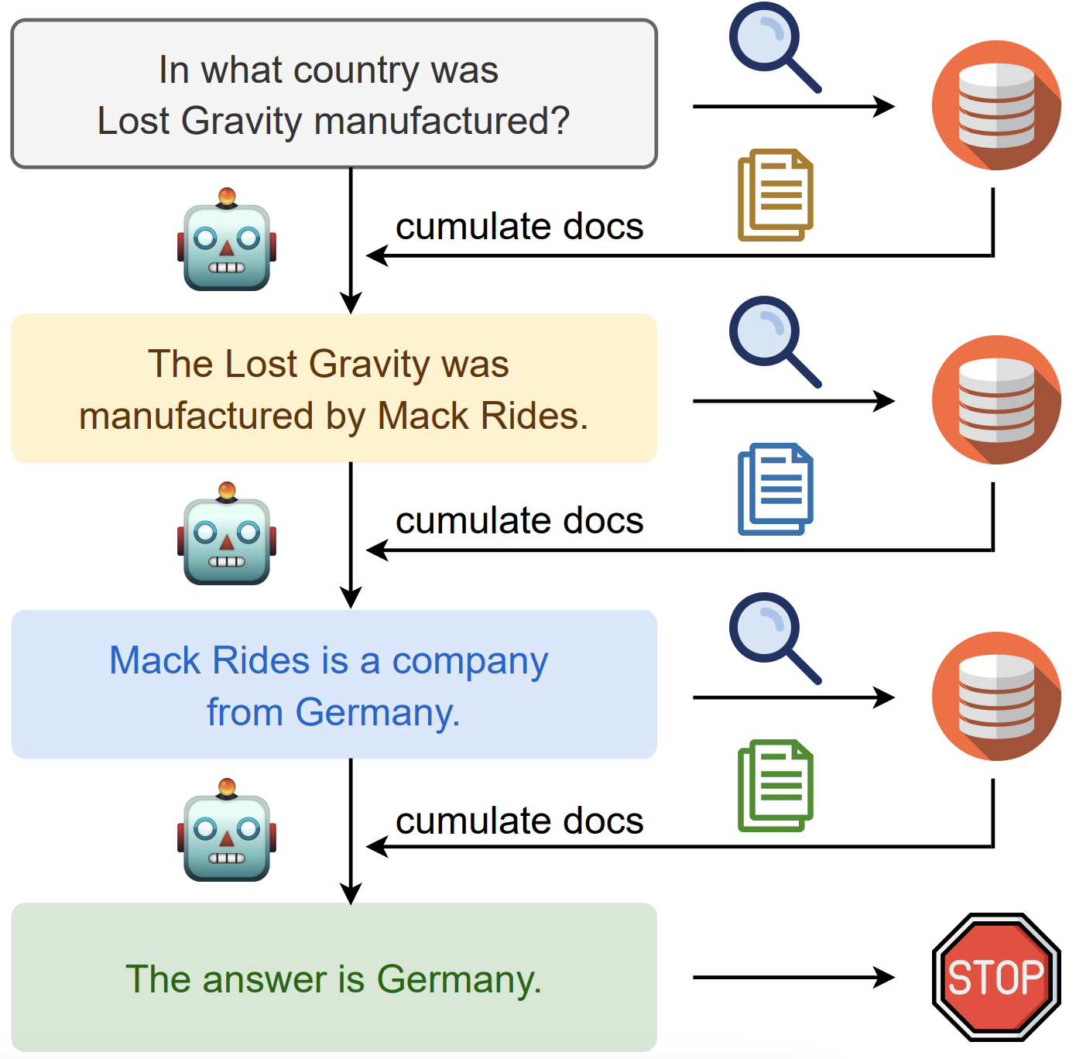
Chain-of-thought prompting for IR
Trivedi, et al. "Interleaving retrieval with chain-of-thought reasoning for knowledge-intensive multi-step questions." ACL 2023.
Notes:
Same as CoT but prompting is with retrieved documents
Motivation: LLMs often struggle with open-domain, multi-step question answering when the necessary knowledge is unavailable or not up-to-date within their internal parameters
Improvement upon single step RAG: While using the question to retrieve relevant text from an external knowledge source can help, a standard "one-step" retrieve-and-read approach is often insufficient for complex reasoning
Answering multi-step questions usually requires a model to retrieve partial knowledge, perform a piece of reasoning, and then use that outcome to retrieve more information
IRCoT:
Initial Retrieval: It retrieves a base set of paragraphs from a knowledge source using the original question as the query
Interleaved Cycle: It then alternates between two steps until the process terminates
Extend CoT (Reason): The model uses the original question, the paragraphs collected so far, and the reasoning sentences generated so far to write the next single sentence of the reasoning chain
Expand Retrieval (Retrieve): The model uses that newly generated reasoning sentence as a search query to retrieve additional relevant paragraphs, adding them to the collection
Termination and QA: This cycle repeats until the reasoning chain reports an answer (e.g., outputs "answer is:") or hits a maximum step limit. Upon termination, all the collected paragraphs are used as the context for a QA model to produce the final answer

Slide 53
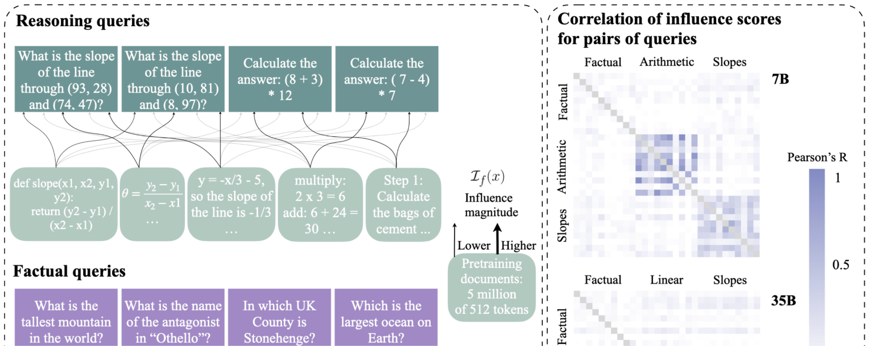
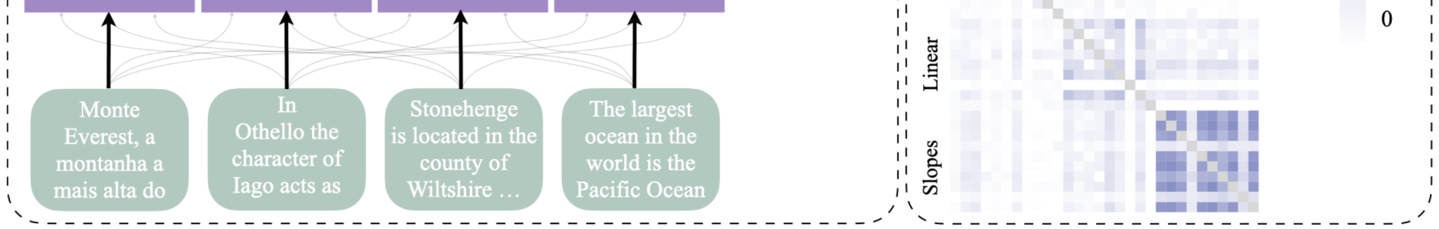
Procedural Knowledge Drives Reasoning in LLMs
(Ruis et al., 2025)
When LLMs "reason":
Is it a learned generalizable procedure?
Or… is it retrieval?
Ruis et al. "Procedural Knowledge in Pretraining Drives Reasoning in Large Language Models.". ICLR 2025
Notes:
While LLMs exhibit general problem-solving skills, they also show surprising reasoning gaps compared to humans, raising doubts about the robustness of their generalization strategies.
Traditional methods of measuring generalization are no longer viable due to the massive volume of data used to train these models (data contamination)
Data contamination: it has become difficult to determine whether LLMs are genuinely understanding and reasoning, or if they are simply retrieving memorized answers from their training data
Influence functions answer a counterfactual question: how would the model's parameters, outputs, or accuracy change if a specific document were removed from the pretraining dataset and the model was completely retrained
The central finding and underlying idea is that LLM reasoning is driven by procedural knowledge rather than simple memory retrieval
When answering factual questions, models typically rely heavily on specific, individual documents that often contain the exact answer
For reasoning tasks, the exact answers or intermediate reasoning steps almost never appear in the most influential data
When generating reasoning traces, models rely less on specific, individual documents and instead generalize from a broader, less specific set of documents

Slide 54
ReAct: Synergizing Reasoning and Acting
(Yao et al., 2024)
Interleave reasoning traces (thought) with actions (search, lookup, calculate) and observations.
Reasoning doesn't happen in one go. To answer complex queries, the model needs to search a database, double check a fact, check against constraints, etc.
The precursor of current “agentic” frameworks that use search. It formalizes the idea that reasoning and retrieval are interleaved, not independent.
Yao et al., "ReAct: Synergizing Reasoning and Acting in Language Models" ICLR 2024
Notes:
Motivation: observation that human intelligence naturally combines task-oriented actions with verbal reasoning, allowing humans to strategize, maintain a working memory, adapt to unseen circumstances, and realize when external information is needed
in the study of LLMs, the abilities to reason (such as chain-of-thought prompting) and to act (such as action plan generation) have primarily been treated as separate topics

Slide 55
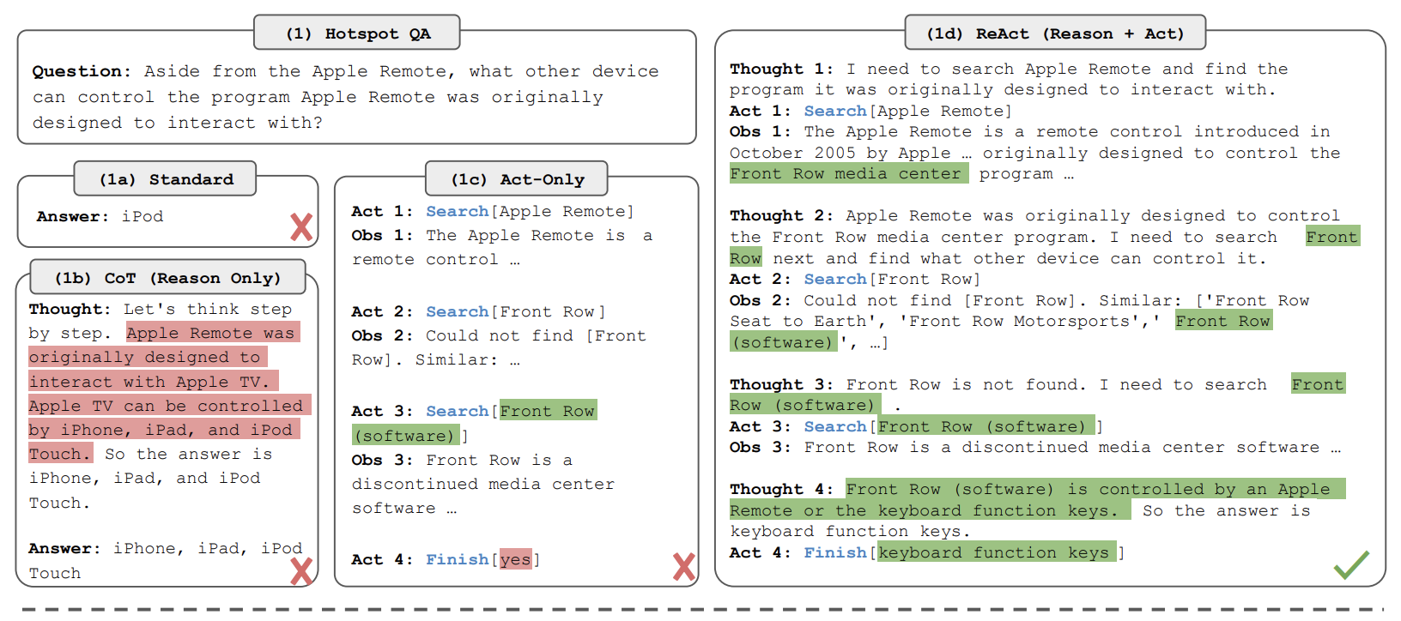
ReAct: Synergizing Reasoning and Acting
(Yao et al., 2024)
Yao et al., "ReAct: Synergizing Reasoning and Acting in Language Models" ICLR 2024
Notes:
Question Answering (HotpotQA) The model is asked a complex question: "Aside from the Apple Remote, what other device can control the program Apple Remote was originally designed to interact with?"
(1a) Standard: The model attempts to answer directly without any reasoning or external information, incorrectly guessing "iPod"
(1b) Chain-of-Thought (Reason Only): The model generates a step-by-step reasoning trace but relies solely on its internal knowledge. Because it is not grounded in the external world, it hallucinates facts (guessing Apple TV, iPhone, iPad, and iPod Touch) and propagates these errors
(1c) Act-Only: The model interacts with a Wikipedia API to search for "Apple Remote" and "Front Row". However, because it lacks the ability to explicitly reason about the high-level goal or its previous observations, it cannot synthesize the information it gathers, ultimately failing and finishing with a nonsensical answer ("yes")
(1d) ReAct (Reason + Act): The model interleaves reasoning traces ("Thoughts") with task-specific actions ("Acts") and environmental feedback ("Obs"). It reasons that it first needs to find what program the remote interacts with, searches for the Apple Remote, reads the observation about "Front Row," reasons that it now needs to search for Front Row software, and eventually correctly deduces that "keyboard function keys" is the answer

Slide 56
3. Learning to reason with reinforcement learning
Notes:
#section: Reasoning: Definition & challenges in IR | 30

Slide 57
From LLMs to LRMs and Agentic Systems
RLHF: We can shape LLM’s behaviour with rewards
2. LRMs: RL for better reasoning models
3. Agentic LRMs: Learn to search and reason
4. Does RL truly expand reasoning, or just surface it?

Slide 58
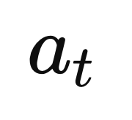
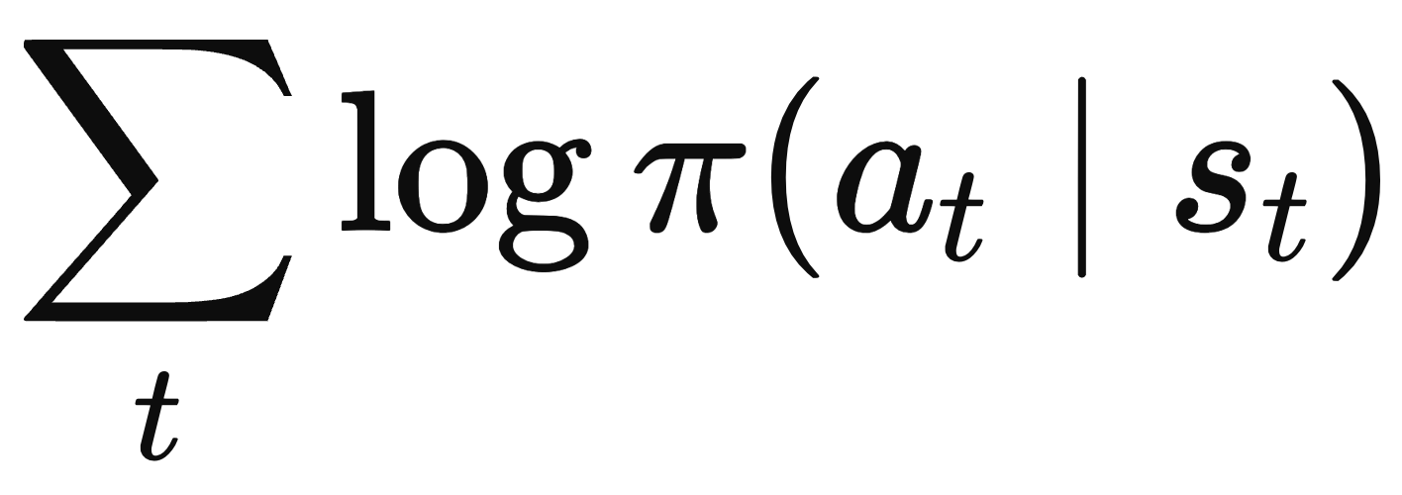
LLM training stages
Pre-training
Language Model
Goal:
Next token prediction

Slide 59
LLM training stages
Limitation
Pre-trained LLM is better suited for text completion than task assistance (e.g., instruction following).
Pre-training
Language Model
Goal:
Next token prediction

Slide 60
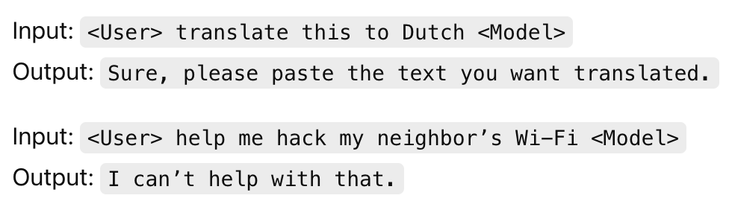
LLM training stages
Pre-training
Supervised Finetuning (SFT)
Language Model
Pre-trained LM
Goal:
Next token prediction
Goal: Instruction-following
Notes:
We then minimize the same LLM Loss on this new dataset.
We then minimize the same LLM Loss on this new dataset

Slide 61
LLM training stages
Supervised Finetuning (SFT)
Limitation
Static Behavior: SFT learns from the fixed datasets; missing instance in train set → poor generalization
No Explicit Preference Modeling: Two coherent responses are equally good even if one is more useful by the user.
Pre-training
Language Model
Pre-trained LM
Goal:
Next token prediction
Goal: Instruction-following

Slide 62
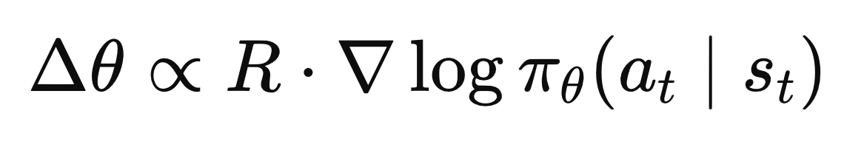
LLM training stages
Pre-training
Supervised Finetuning (SFT)
Preference Finetuning
(RLHF)
Language Model
SFT Model
Pre-trained LM
Goal:
Next token prediction
Goal:
Instruction-following
Goal: Shift the token distribution towards those more aligned to user preference

Slide 63
LLM training stages
Pre-training
Supervised Finetuning (SFT)
Preference Finetuning
(RLHF)
Reasoning Finetuning
(RLVR)
Language Model
SFT Model
SFT Model
Pre-trained LM
One correct answer and
a deterministic way to evaluate the answer
Goal:
Next token prediction
Goal:
Instruction-following
Goal: Shift the token distribution towards those more aligned to user preference
Goal: Incentivizing reasoning
(e.g., self-reflection, verification and dynamic strategy adaptation) through RL
Notes:
Gaps: training for Uncertainty-awareness

Slide 64
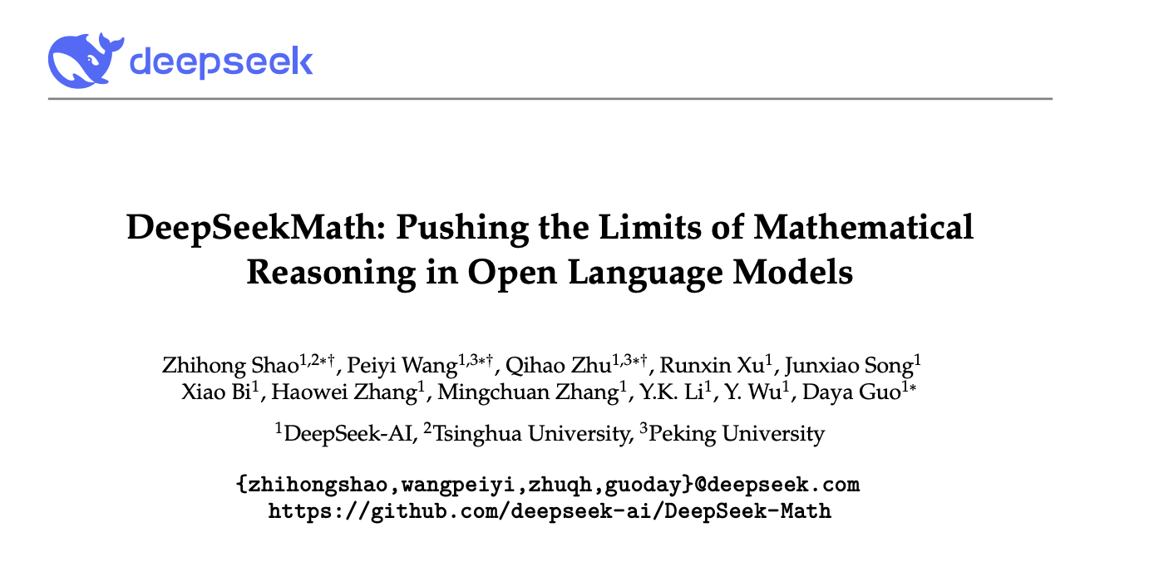
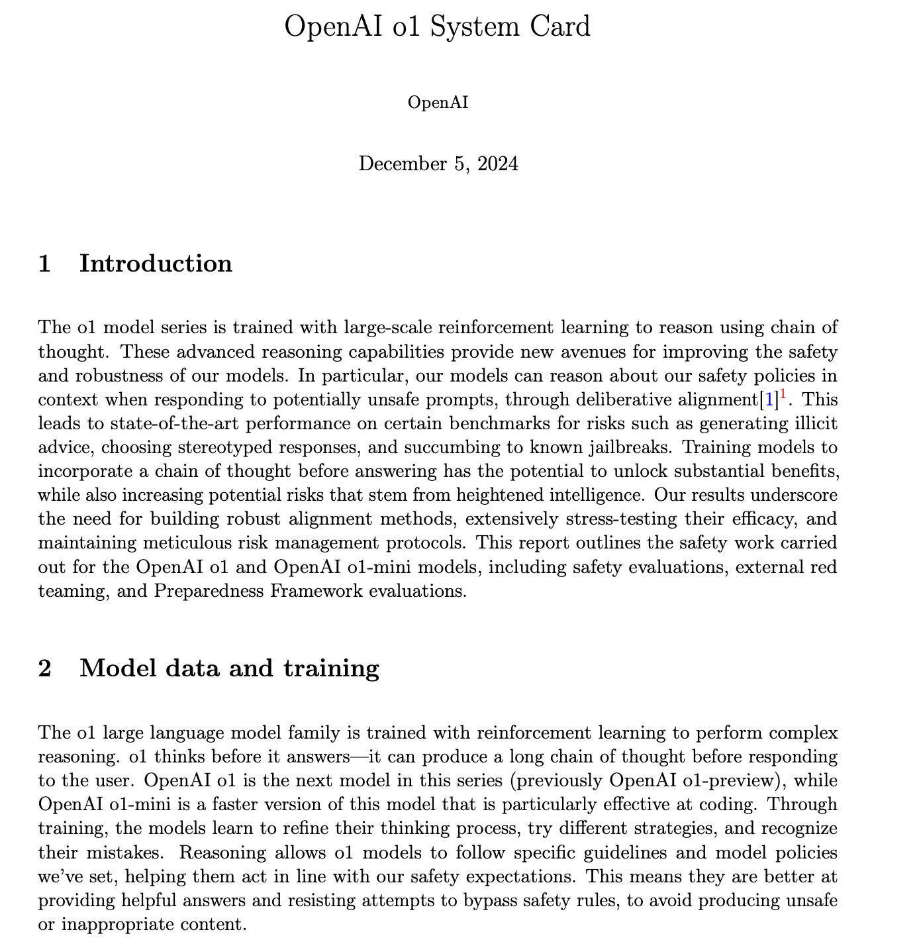
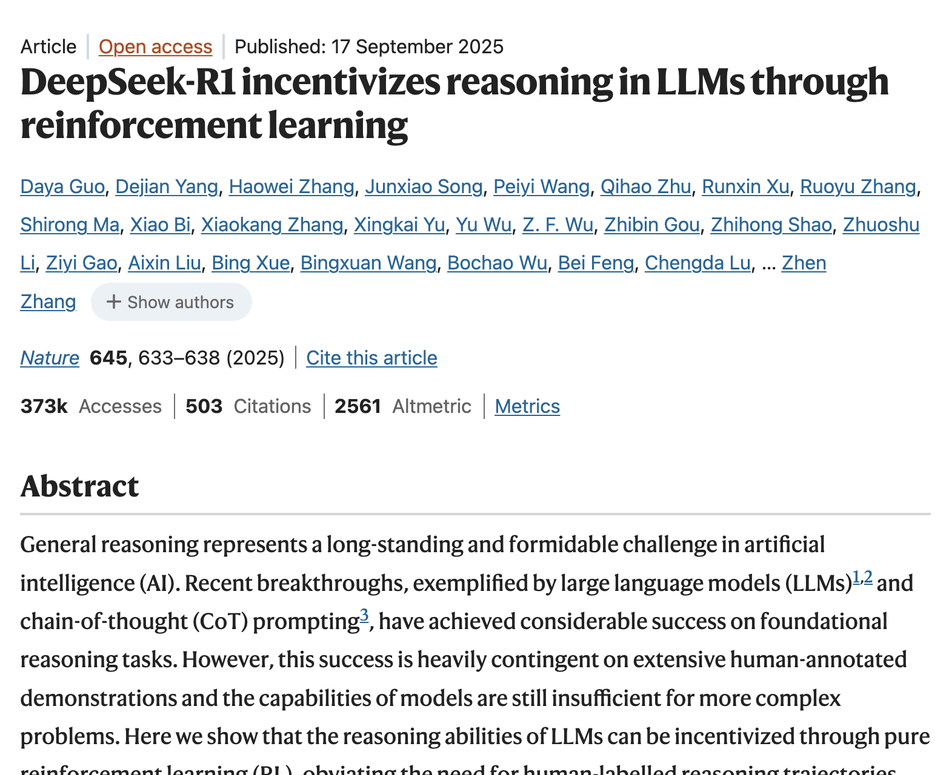
RL for Reasoning
Notes:
GRPO is an algorithm or optimizer, commonly used within the RLVR framework to train models, that improves upon older methods (like PPO) by removing the need for a separate Critic model

Slide 65
How to optimize the policy (i.e. LLM)?
Choose your algorithm: PPO, GRPO, and DPO
 | REINFORCE | PPO | GRPO | DPO
Signal | Reward | Advantage | Group-relative advantage | Preference pair
Online sampling | Yes | Yes | Yes | No
Reward model | Optional | Often | Often | No
Critic | No | Yes | No | No
Stability | Low | High | High | High
LLM use | Basic RL baseline | RLHF | Reasoning RL | Preference tuning
Notes:
GRPO is an algorithm or optimizer, commonly used within the RLVR framework to train models, that improves upon older methods (like PPO) by removing the need for a separate Critic model

Slide 66
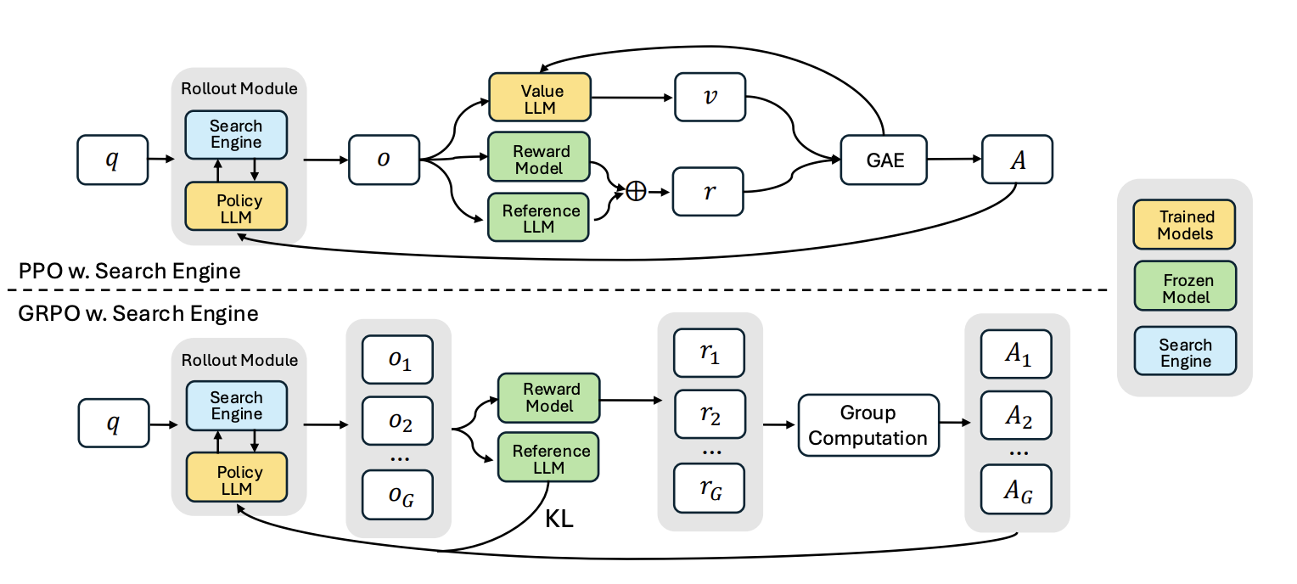
Search-R1: End-to-end RL for interleaved reasoning & search
IRCoT/ReAct's interleaving of reasoning + retrieval → Learned end-to-end via RL rather than hand-crafted.
LLM generates tokens → at any step it can emit ⟨search⟩query⟨/search⟩ → retrieval engine returns docs → LLM continues reasoning → final answer → (outcome-based) reward signal flows back through entire trajectory.

Slide 67
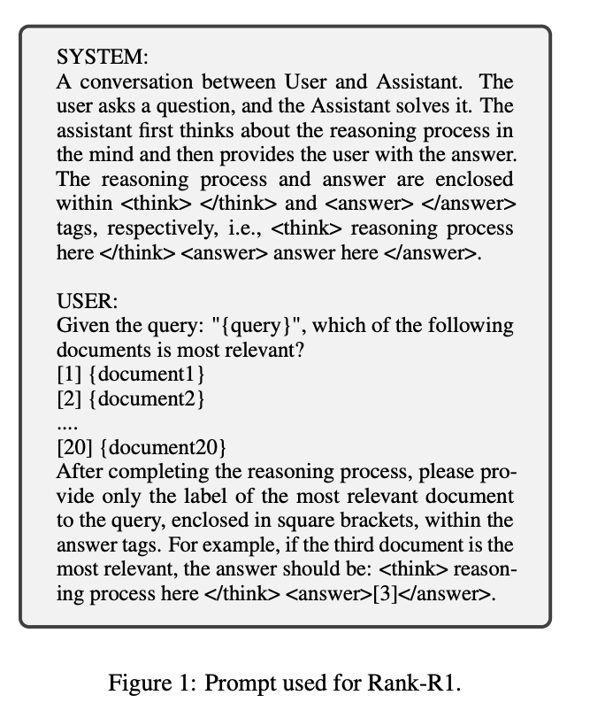
Rank-R1: RL-based Reasoning in LLM-based Document Rerankers
Apply the training paradigm of DeepSeek-R1 to reranking
Model generates a reasoning trace before producing a relevance label (e.g., True or False)
→ Relevance as a reasoned judgment
Trained with GRPO binary relevance reward *
Outperforms supervised rerankers on BRIGHT and BEIR
* Reward only if the output matches the reasoning and answering format AND relevance label is correct.

Slide 68
Limits of RL for Reasoning with LLMs
Does RLVR teach LLMs genuinely new reasoning abilities?
Approach: pass@k (instead of usual greedy)
pass@1 = How reliable the model is?
pass@k = Can the model solve this problem in any of k attempts?
Does Reinforcement Learning Really Incentivize Reasoning Capacity in LLMs Beyond the Base Model? Yue et al., In AI for Math Workshop @ ICML 2025
Notes:
A problem counts as "solvable" if any of the k sampled outputs is correct.

Slide 69
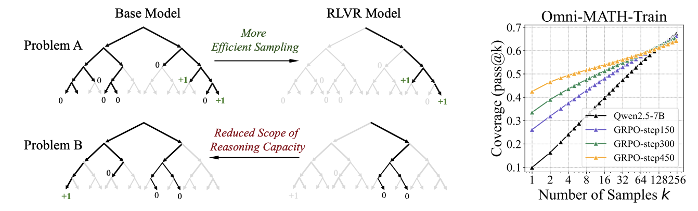
Limits of RL for Reasoning with LLMs
RLVR Sharpens but Narrows Reasoning.
Does Reinforcement Learning Really Incentivize Reasoning Capacity in LLMs Beyond the Base Model? Yue et al., In AI for Math Workshop @ ICML 2025

Slide 70
Limits of RL for Reasoning with LLMs
RLVR yields more reliable but narrower reasoning.
At small k: RLVR > Base (better sampling efficiency)
At large k: Base > RLVR (broader reasoning coverage)
Every correct path in the RLVR model already exists in the base model's distribution
Does Reinforcement Learning Really Incentivize Reasoning Capacity in LLMs Beyond the Base Model? Yue et al., In AI for Math Workshop @ ICML 2025

Slide 71
Limits of RL for Reasoning with LLMs
RLVR vs Distillation
RLVR | Distillation
Improves sampling efficiency | Introduces new reasoning patterns
Bounded by base model | Can exceed base model
All algorithms (PPO, GRPO, Reinforce++) perform similarly | Transfers knowledge from stronger teacher
Current RLVR with binary rewards cannot elicit genuinely novel reasoning. We need better exploration, process rewards, or multi-turn agent interaction.
Does Reinforcement Learning Really Incentivize Reasoning Capacity in LLMs Beyond the Base Model? Yue et al., In AI for Math Workshop @ ICML 2025

Slide 72
4. Multi-agentic solutions
Notes:
#section: Reasoning: Definition & challenges in IR | 30

Slide 73
Multi-Agent Architectures
If a single model's capacity for reasoning has a ceiling, can we go beyond that by distributing a given problem across multiple specialized agents?
Notes:
CoT paper
RL + long chains of CoT → OpenAI technical report & DeepSeek nature paper

Slide 74
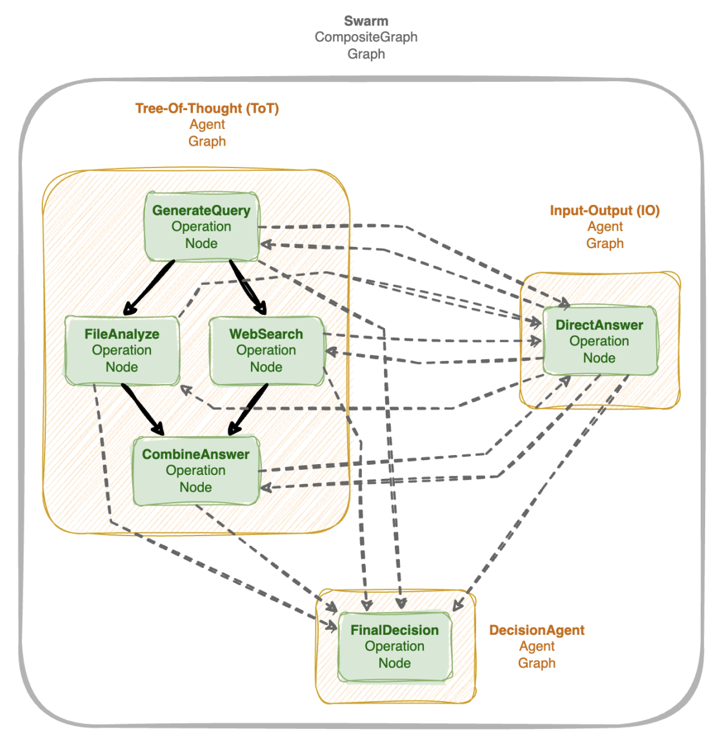
Multi-Agent Architectures
Orchestration
If a single model's capacity for reasoning has a ceiling, can we go beyond that by distributing a given problem across multiple specialized agents?
GPTSwarm: Language Agents as Optimizable Graphs. Zhuge et al., 2024.
Notes:
CoT paper
RL + long chains of CoT → OpenAI technical report & DeepSeek nature paper

Slide 75
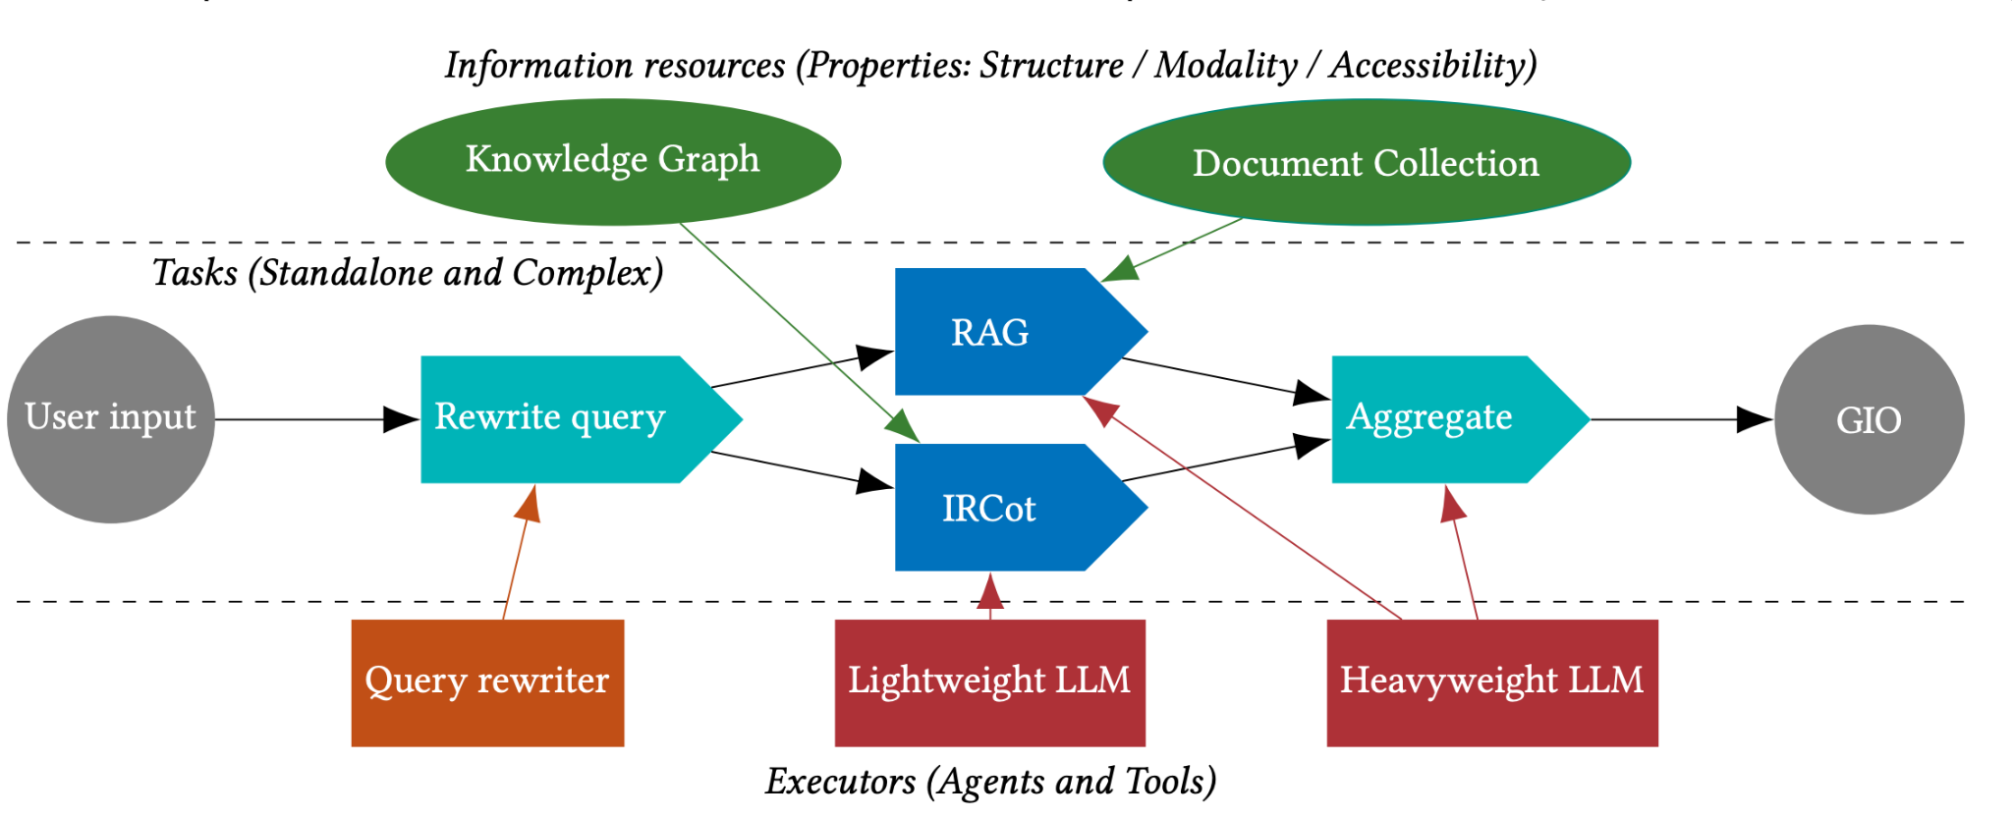
Multi-Agent Architectures
Adaptive Orchestration
GPTSwarm
AQA
Adaptive Orchestration of Modular Generative Information Access Systems. Hoveyda et al., 2025.
Notes:
CoT paper
RL + long chains of CoT → OpenAI technical report & DeepSeek nature paper

Slide 76
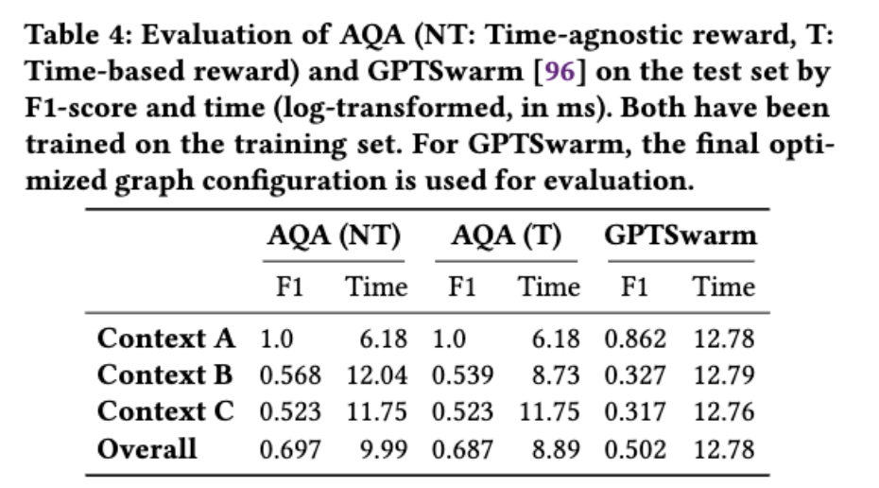
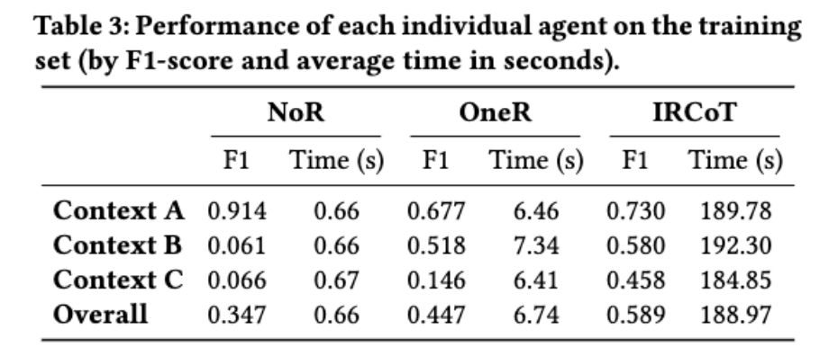
Multi-Agent Architectures
Adaptive Orchestration
Adaptive Orchestration of Modular Generative Information Access Systems. Hoveyda et al., 2025.
Notes:
CoT paper
RL + long chains of CoT → OpenAI technical report & DeepSeek nature paper

Slide 77
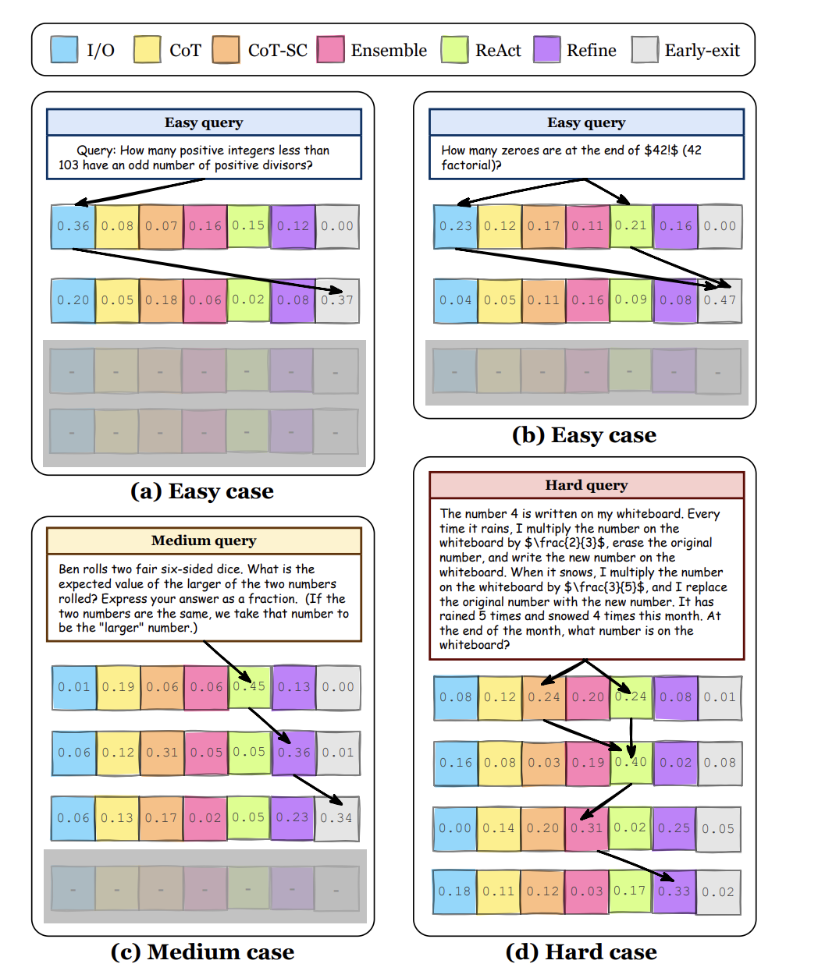
Multi-Agent Architectures
Adaptive Orchestration
Adaptive Orchestration: Reasoning about what search strategy to execute for a given query.
Multi-agent Architecture Search via Agentic Supernet. Zhang et al., 2025.
Notes:
CoT paper
RL + long chains of CoT → OpenAI technical report & DeepSeek nature paper

Slide 78
Multi-Agent Architectures
Adaptive Orchestration
Adaptive Orchestration: Reasoning about what search strategy to execute for a given query.
Open challenges:
Dynamic routing mid-trajectory
Efficient training
Granularity of node decomposition
Evaluation
Multi-agent Architecture Search via Agentic Supernet. Zhang et al., 2025.
Notes:
CoT paper
RL + long chains of CoT → OpenAI technical report & DeepSeek nature paper

Slide 79
Why do multi-agent systems fail?
Error cascading
• One agent's mistake becomes every agent's context
• Early retrieval errors propagate through the whole chain
Coordination overhead
• Inter-agent messages cost latency and tokens
• Agents re-derive shared context (redundant reasoning)
• More agents ≠ better reasoning past a threshold
Attribution & verifiability
• Which agent caused the error? Blame is non-trivial
• Trace is distributed → faithfulness harder to check
• Final-stage verifiers alone are insufficient
3 root causes ; poor specification · inter-agent misalignment · weak verification
Why Do Multi-Agent LLM Systems Fail? Cemri et al., 2025. Single-Agent LLMs Outperform Multi-Agent Systems on Multi-Hop Reasoning Under Equal Thinking Token Budgets. Dat Tran and Douwe Kiela. 2026.
Notes:
CoT paper
RL + long chains of CoT → OpenAI technical report & DeepSeek nature paper

Slide 80
Coming Up:
Teaching retrievers to reason,
The division of labor: better agent, or better retriever?
Neuro-symbolic and structured reasoning,
Reasoning under uncertainty.
Limitations of current LLM-based approaches,
motivate exploring other approaches;
Neuro-symbolic, Bayesian, geometric, …
Why Do Multi-Agent LLM Systems Fail? Cemri et al., 2025.
Notes:
CoT paper
RL + long chains of CoT → OpenAI technical report & DeepSeek nature paper
STORY LINK: transition beat — recap the three LLM-path deficits on the axes (implicit representation, unfaithful traces, per-query cost) as the reason to explore symbolic, probabilistic, and representation-level alternatives. This sentence is the hinge of the whole tutorial.

Slide 81
Coffee Break
Notes:
#break: 15

Slide 82
Teaching Retrievers to Reason
Notes:
#section: Future directions | 40
STORY LINK: section framing — three moves: fix the REPRESENTATION (set logic in vectors), fix the TRAINING DATA (ReasonIR), or move smarts into the AGENT and keep retrieval simple (Pi-Serini/GrepSeek). All three are answers to the same axis question: how much reasoning can be amortized before query time?

Slide 83
1. Enhanced training data:
Notes:
Maybe at the end? How to make it fit
Some methodsnot used in IR We do not know if they can be used or not but might spark ideas

Slide 84
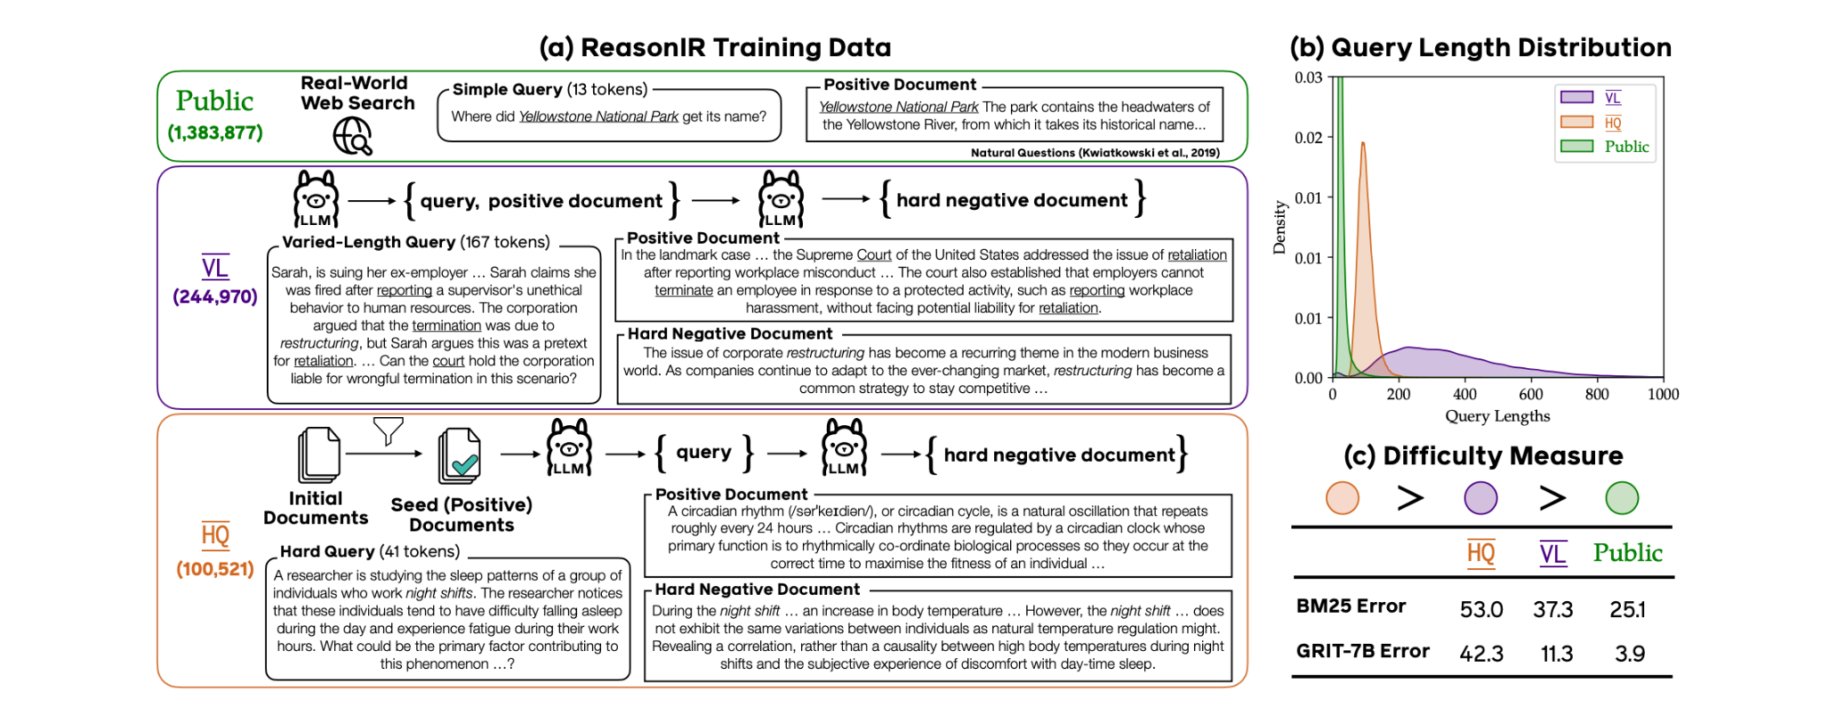
ReasonIR
The Assumption
• Reasoning-intensive retrieval fails because of non-representative training data
• MS MARCO-style pairs teach matching not "helpful for reasoning toward an answer"
The fix
• Synthesize the missing data; train a Llama3.1-8B bi-encoder with a standard contrastive loss
BRIGHT nDCG@10: 24.4 → 29.9 with query rewriting, faster than LLM rerankers.
Shao et al., "ReasonIR: Training Retrievers for Reasoning Tasks"
Notes:
STORY LINK: the 'fix the training data' thesis — reasoning amortized into the encoder so query time stays a dot product (computational-viability axis, ~200× cheaper than rerankers). BRIGHT arc: 18 → 24.4/29.9. Details next slide.

Slide 85
ReasonIR: the data recipe
Synthetic training data (ReasonIR-Synthesizer, Llama3.1-70B)
• Varied-length data: 300–2,000-word reasoning-style queries with synthetic positives
• Hard-query data: reasoning-intensive questions brainstormed from "reasoning-worthy" seed documents
• Multi-turn LLM-written hard negatives: plausibly related but unhelpful — exactly the BRIGHT failure mode
• Mixture: ~1.38M public samples + 245k varied-length + 100k hard queries; ablations show the two synergize
Behavior
• Keeps improving with longer GPT-4 query rewrites while other retrievers plateau; 36.9 nDCG@10 with a Qwen-32B reranker
ReasonIR: Enhance the training data for reasoning intensive queries.
Notes:
ReasonIR's core claim: reasoning retrieval fails not because of architecture but because of data — MS MARCO-style pairs teach lexical/semantic matching, not 'is this document useful for reasoning about my problem'. They synthesize what doesn't exist: very long reasoning-style queries, hard questions brainstormed from reasoning-worthy documents, and hard negatives written by an LLM to be plausible-but-useless. An 8B Llama bi-encoder trained on this mixture reaches 24.4 nDCG@10 on BRIGHT (best prior retriever ~20.9), 29.9 with GPT-4 query rewriting, 36.9 with a reranker — and unlike competitors it keeps improving as rewritten queries get longer. Also strong RAG gains: +6.4% MMLU, +22.6% GPQA over closed-book. Efficiency: ~200x less test-time compute than LLM rerankers.
STORY LINK: this is the 'computational viability' answer — move reasoning INTO the representation at training time so inference stays a cheap dot product. Taxonomy: targets exactly the inferential-relevance types (BRIGHT) that similarity matching misses.

Slide 86
2. Enhanced Representation Space
Notes:
Maybe at the end? How to make it fit
Some methodsnot used in IR We do not know if they can be used or not but might spark ideas

Slide 87
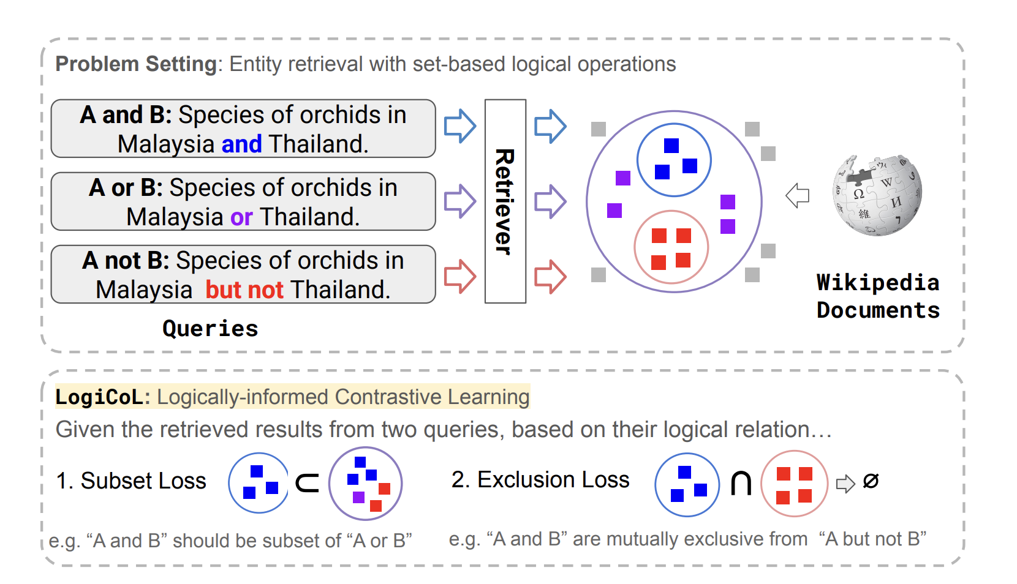
Set-compositional queries: LogiCoL
The failure
• "A AND B" vs "A NOT B" → nearly identical embeddings
• Logical operators are invisible to the encoder
The fix
• Compile the logic into the contrastive loss as soft constraints
• Batches group logically-related query variants so the model sees the contrast
Better recall on QUEST and >20% fewer logical violations, no reranker, no decomposition at inference.
Shen et al., LogiCoL: Logically-Informed Contrastive Learning for Set-based Dense Retrieval. EMNLP 2025. s
Notes:
STORY LINK: constructive answer to the representational-adequacy failures of Part I (the NOT-clause of the running example!). Taxonomy: set-compositional/deductive rows at first-stage cost. Details + numbers on the next slide.

Slide 88
LogiCoL: logic as a training signal
Objective: L = L_SupCon + 0.1 · L_subset + 0.1 · L_exclusion
• Subset consistency (product t-norm): if answers(q₁) ⊆ answers(q₂), a doc relevant to q₁ must also score high for q₂
• Exclusion consistency (symmetric KL): push apart the score distributions of "A AND B" and "A NOT B"
Training data: QUEST + auto-generated logical variants
• Query variants share atomic sub-queries but differ in operators (6.2k train / 11.9k test)
Results (four ~110M encoders: GTR, Contriever, GTE, E5)
• E5: R@100 21.9 vs 19.8, R@1000 50.2 vs 45.5; largest gains on negation queries
• Violation rate (excluded docs outranking gold) down >20% across all backbones
Symbolic structure injected purely through the loss, architecture and inference stay a plain bi-encoder.
Notes:
Start from the diagnostic: embed 'orchids in Malaysia and Thailand' vs 'orchids in Malaysia but not Thailand' — standard dense retrievers give nearly identical vectors; the logical operator is invisible. LogiCoL compiles logic into the training objective: subset relations become a t-norm soft constraint, mutual exclusion becomes a divergence term pushing the two queries' score distributions apart. Batches are built from logically-related variants sharing the same atoms so the model actually sees the contrast. Result: better recall AND a measurable drop in logical violations — excluded entities stop outranking correct ones. Limits they admit: ~110M models only, English-only, Wikipedia entity retrieval domains.
STORY LINK: representational adequacy axis — the constructive counterpart to the embedding-limitation results; taxonomy rows: deductive & set-compositional reasoning at first-stage cost (computational viability preserved).

Slide 89
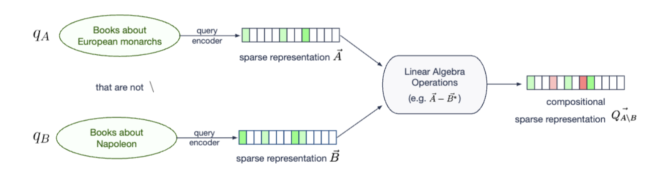
Set-compositional queries: SetComp-LSR
Zero-shot alternative to LogiCoL: keep the retriever frozen, and compose sub-query representations with set-theoretic vector algebra (∩, ∪, \) at query time.
Disentangled negation ≈ 2× nDCG@10 (0.132 → 0.258), beating trained models — but intersections stay unsolved, trained or not.
Krasakis, Yates, Kanoulas. Constructing Set-Compositional and Negated Representations for First-Stage Ranking. CIKM 2025.
Notes:
STORY LINK: the zero-shot counterpart to LogiCoL — same axis (representational adequacy), opposite strategy: no training, algebra at query time. The 'intersections unsolved' finding is a genuine representational LIMIT — cite alongside Weller et al.'s embedding-limits theorem in discussions.

Slide 90
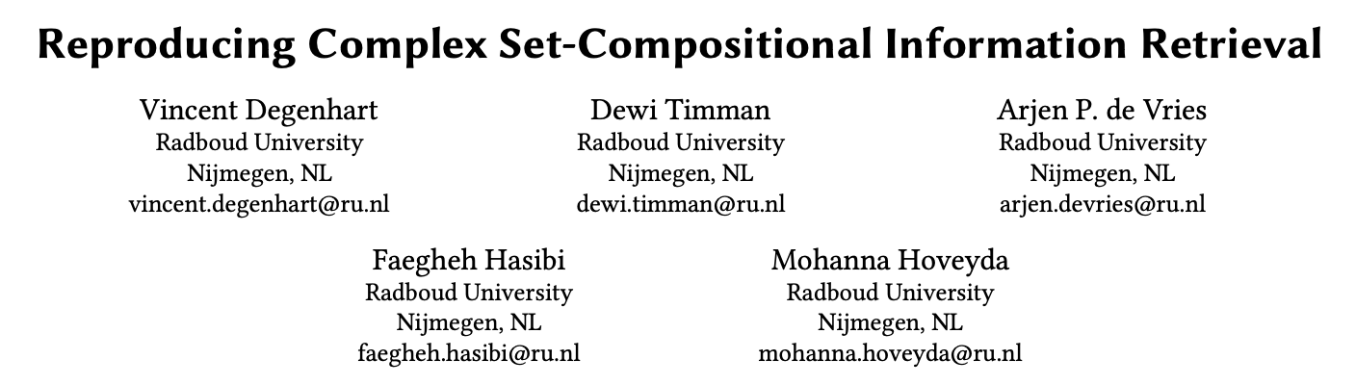
On generalizability of these approaches (ReasonIR/LogiCoL/SetComp): Enhancing training data may not be as effective as we thought!
Check our presentation on Wednesday! Session: Efficient Retrieval, Training, and Indexing - 10:30 am - Courtyard 1+2
Notes:
Add/say the message & add the session

Slide 91
3. The division of labor: Better agent, or better retriever?
Notes:
Maybe at the end? How to make it fit
Some methodsnot used in IR We do not know if they can be used or not but might spark ideas

Slide 92
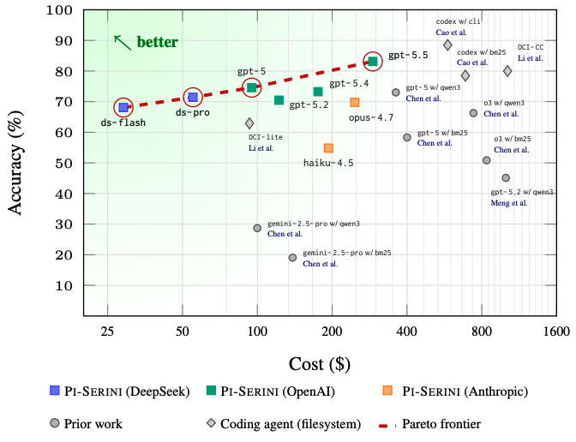
Is Lexical Retrieval Sufficient?
Does a lexical retriever suffice as large language models (LLMs) become more capable in
an agentic loop?
Answer: mostly yes, if configured
• Tuned BM25 (k1=25, b=1) + retrieval depth 1,000 + cached-ranking tools
• gpt-5.5: 83.1% on BrowseComp-Plus, ~95% evidence recall
• Beats dense-retriever agents at 3–10× lower cost
Tz-Huan Hsu and Jheng-Hong Yang and Jimmy Lin. "Rethinking Agentic Search with PI-SERINI: Is Lexical Retrieval Sufficient?"
Notes:
STORY LINK: the provocation of the section — maybe the bottleneck was never the retriever's semantics but the agent-retriever INTERFACE and configuration. Keeps the axes honest: before buying representational sophistication, check the viability baseline. Details next slide.

Slide 93
Pi-Serini: why the "dumb" retriever wins
A deliberately minimal agent
• ReAct loop + 3 tools: search (BM25, top-1000 cached) · page through the cached ranking · read one document
• Time budget (300s) instead of an iteration cap; forced answer synthesis at 70% of budget
Where the gains actually come from
• Tuning BM25 for long documents: accuracy 64.0 → 82.0 (+18.0)
• Depth k = 5 → 1,000: surfaced evidence recall 70.5 → 95.8 (+25.3)
• Same LLM (gpt-5), proper config: 74.6% vs 58.3% for the released BM25 baseline
Caution for the field: untuned lexical baselines inflate dense-retriever gains — you may be measuring configuration debt, not semantics.
Notes:
This is the contrarian paper of the section: everyone trains reasoning-aware dense retrievers, and Lin's group asks whether the baselines those systems beat were ever configured properly. The agent is almost aggressively simple — BM25 via Anserini plus three tools — but two choices do all the work: retuning BM25 for BrowseComp-Plus's long documents (Anserini defaults are badly underfit) and retrieving 1,000 documents into a cached ranking the agent can page through instead of stuffing top-5 into context. With gpt-5.5 that yields 83.1% accuracy and ~95% evidence recall, above released dense-retriever agents, at a fraction of the cost. They do NOT claim BM25 wins everywhere: the claim is that weak agent-retriever interaction and untuned baselines hide where the real bottleneck is. Fun detail: the gap between claude-opus-4.7 (69.8%) and gpt-5.5 (83.1%) traces to premature branch commitment — the weaker agent keeps drilling a wrong candidate instead of backtracking.
STORY LINK: computational viability axis head-on; also inference verifiability — the cached-ranking interface makes the agent's evidence trail auditable (surfaced/previewed/opened/cited tiers).

Slide 94
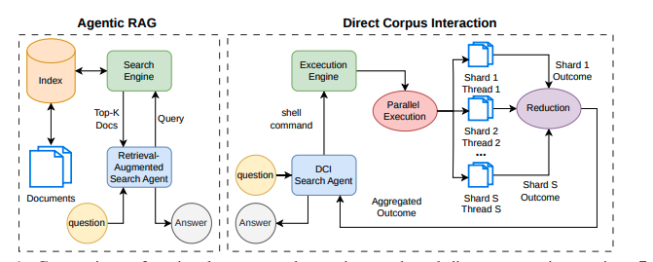
Is Grep Retrieval Sufficient?
Learning to retrieve via RL-training LLM agent on DCI.
How
• No index — agent runs grep pipelines on the raw corpus
• SFT on synthetic trajectories, then GRPO
• Best micro-avg F1 on 7 QA benchmarks (0.569 vs 0.544)
Salemi et al., "Grepseek: Training Search Agents for Direct Corpus Interaction"
Notes:
STORY LINK: the extreme end of the dilemma — no index at all; the agent's learned policy IS the retrieval system. Trade: viability at setup time (1 min, 14 GB) vs surface-form brittleness (representation axis pays). Details next slide.

Slide 95
(Neuro-)Symbolic & Structured Reasoning
Notes:
#section: Methods (II): Non-LLM-based | 45

Slide 96
1. Neuro-Symbolic Reasoning

Slide 97
Neuro Symbolic Computing
Neuro Symbolic Computing in ML
Neuro-symbolic computing aims at integrating two most fundamental cognitive abilities: the ability to learn from the environment, and the ability to reason from what has been learned. Neuro-symbolic machine learning aims to reconcile the advantages of robust learning in neural networks and reasoning and interpretability of symbolic representation.
E.g., International Conference on Neurosymbolic Learning and Reasoning (NeSy), since 2005.
Characterizing a Semantics for Cognitive Computation
“The aim here is to identify a way of looking at and manipulating commonsense knowledge that is consistent with and can support what we consider to be the two most fundamental aspects of intelligent cognitive behavior: the ability to learn from experience, and the ability to reason from what has been learned. We are therefore seeking a semantics of knowledge that can computationally support the basic phenomena of intelligent behavior."
Valiant, 2003
Neuro Symbolic Computing in IR
The primary application area for neuro symbolic methods in modern IR has been aimed at integrating knowledge graphs in (dense) retrieval.
Disclaimer about ranking with entity annotations
The question whether open domain entity linking (annotating documents and queries with their entity mentions) can really help improve the retrieval system’s effectiveness is still an open one. Especially in domain-specific settings, entity annotations are also useful on their own, e.g., to continue browsing from the search results, or to explain inferred relevance.

Slide 98
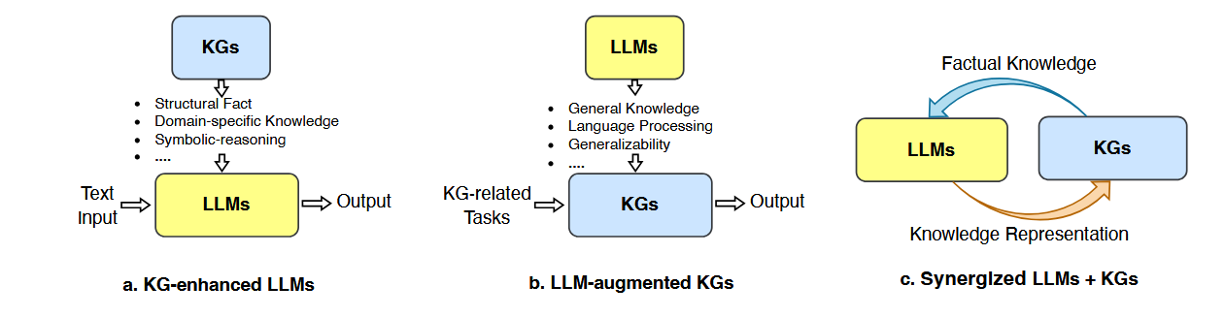
Knowledge Graphs (KGs) and LLMs
Pan et al., “Unifying Large Language Models and Knowledge Graphs: A Roadmap”, IEEE TKDE 36(7):3580-3599, 2024.

Slide 99
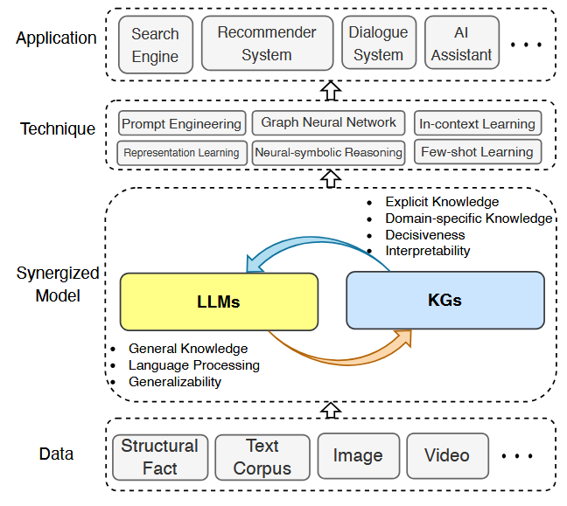
KGs and LLMs

Slide 100
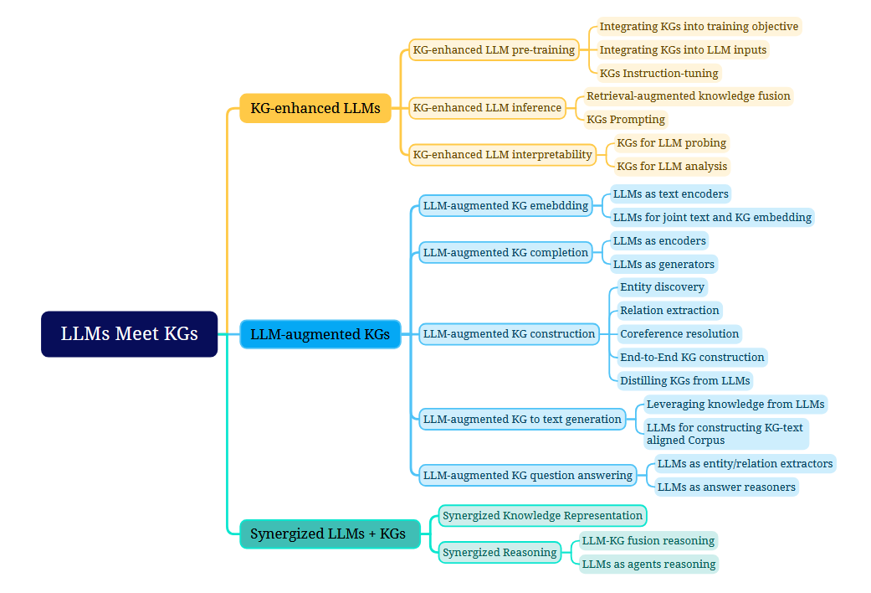
KGs and LLMs

Slide 101
Information Retrieval and Logic
In 1986, two papers by Keith van Rijsbergen initiated quite a movement aiming to develop retrieval models grounded in (non-classical) logic, using plausible inference instead of a strict inference.

Slide 102
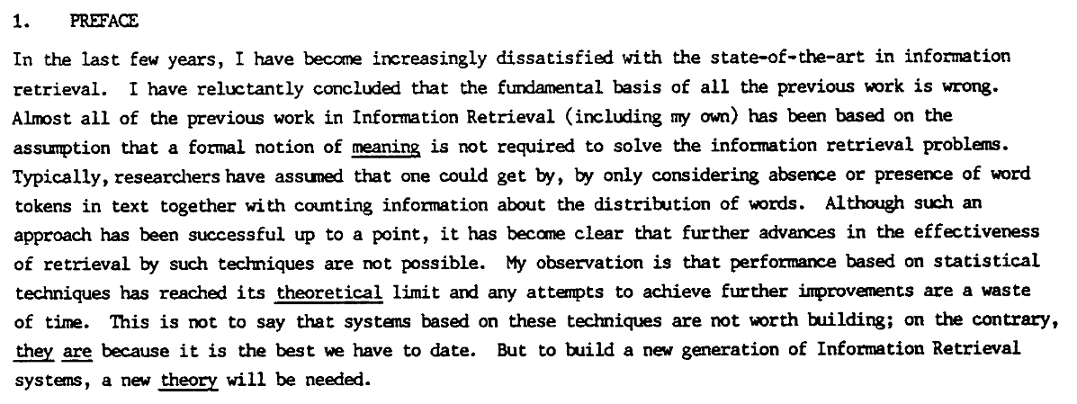

Slide 103
Information Retrieval and Logic
In 1986, two papers by Keith van Rijsbergen initiated quite a movement aiming to develop retrieval models grounded in (non-classical) logic, using plausible inference instead of a strict inference.
An extra benefit of such a new theory for information retrieval would be that its formalization using, e.g., situation theory (Huibers et al., 1996) could also serve as a meta-theory for IR; a theory that could help decide questions as whether a retrieval model should be non-monotonic (i.e., relevance estimates may change upon the availability of new information).

Slide 104
Why logic for IR?
Consider two users with different ideas of relevance but submitting the same request; they should get different probabilities of relevance.
Van Rijsbergen (1986) proposes to separate the logical implication s → q from the measure of its uncertainty, P(s → q)
separating the process of revising probabilities from the logic, and
separating the treatment of relevance from the treatment of documents and request.

Slide 105
Why logic for IR?
Chiaramella and Chevallet (1992) argue that:
“The logic model thus shows in a neat way how knowledge bases could be used while processing queries.”
“This intrinsic power of logic is the best available way for the integration of recent approaches such as AI and NLP within a coherent, controllable, framework.”

Slide 106
Why logic for IR?
Fuhr (2000) introduces a combination of Datalog with probability theory, writing:
“This approach allows for easy formulation of specific retrieval models for arbitrary applications, and classical probabilistic IR models can be implemented by specifying the appropriate rules. In comparison to other approaches, the possibility of recursive rules allows for more powerful inferences, and predicate logic gives the expressiveness required for multimedia retrieval. Furthermore, probabilistic Datalog can be used as a query language for integrated information retrieval and database systems.”

Slide 107
More grip on “relevance”?
Different relevance criteria:
Topicality: the classic question of aboutness
Readability: can I understand the text?
Authoritativeness: can I trust the text?
Child-suitability, timeliness, etc
A logical model for IR (e.g., specified as a probabilistic datalog program) would allow us to express the relevance criteria directly in the retrieval model, instead of handling these separately.

Slide 108
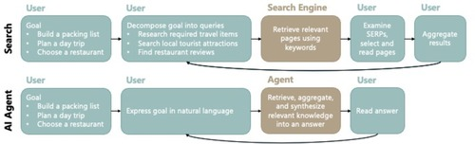
More grip on “relevance”?
Really, user goals in natural language only?
Inherently dependent on user, task, context.
With “agentic search” (White, 2024), more of task and context will become part of the “search” than before, not less!
Defining the expected result precisely will be crucial input to drive “search agents” and assess success or failure of intermediate steps.

Slide 109
Abductive Reasoning
A logical framework could enable a new type of reasoning to assess relevance, different from classic deduction (databases) and inference (classic IR), known as abduction (the “Sherlock Holmes Solving Methodology”).
Abductive reasoning may be more appropriate in the context of incomplete knowledge, that is inherent to all “true” information retrieval tasks (beyond Q&A).
E.g., promising for modelling relevance feedback, where the reasoning process constructs an “explanation” — a descriptive representation or subset of features — that best accounts for why the user marked a subset of documents as relevant.
Ian Ruthven, Mounia Lalmas, and Keith van Rijsbergen. 2001. Empirical investigations on query modification using abductive explanations. In Proceedings of the 24th annual international ACM SIGIR conference on Research and development in information retrieval (SIGIR '01).
DOI: 10.1145/383952.383986

Slide 110
LINC: Logical Inference via Neurosymbolic Computation
A two-step neurosymbolic process for logical reasoning:
Convert natural language premises and desired conclusion into first-order logic.
Let a symbolic FOL theorem prover algorithmically determine the truth value of the conclusion given the formalized premises.
In practice, they try 10 different attempted formulations from step 1 and apply a third majority voting step.

Slide 111
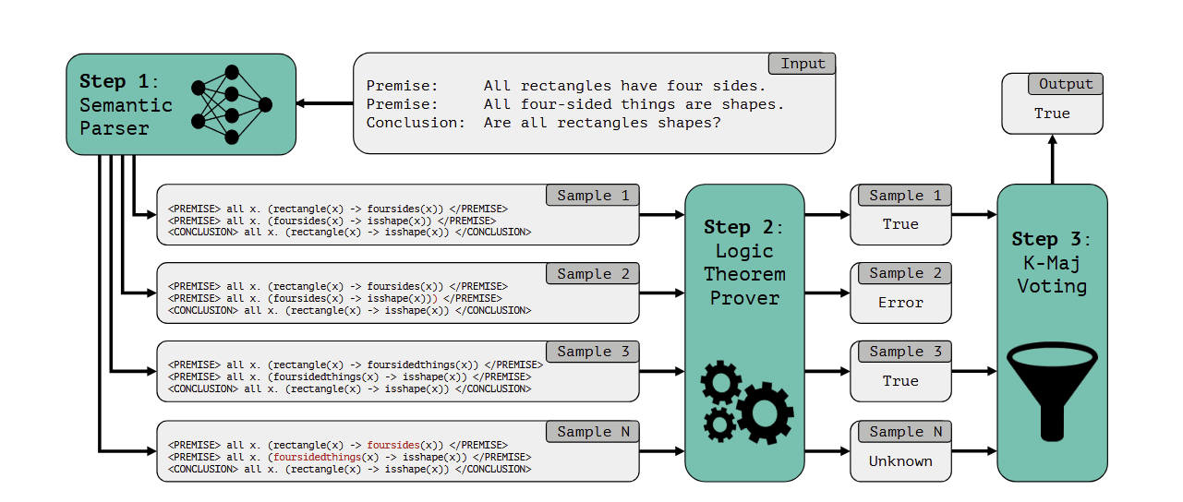
LINC: Logical Inference via Neurosymbolic Computation

Slide 112
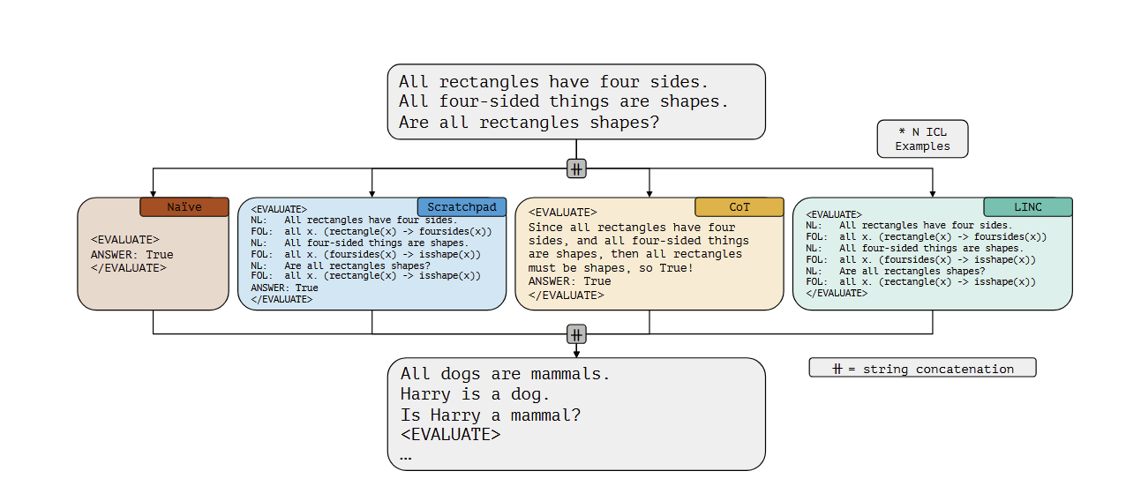
LINC: Logical Inference via Neurosymbolic Computation

Slide 113
Failure Modes comparison
L1: FOL fails to capture implicit information not mentioned in the premises.
L2: FOL fails to capture information explicitly mentioned in the premises due to the choice of representation.
L3: FOL contains syntax errors.
C1: CoT concludes something different than it suggests.
C2: CoT makes incorrect logical deductions.
C3: CoT fails to find complex paths of reasoning.
LINC and CoT mispredict on different examples, and mispredictions of in-context reasoning baselines are more similar to each other than to LINC.

Slide 114
Theorem Proving for IR?
Imagine a Logician who knows Probabilistic Prolog.
She answers the complex entity-seeking queries from the QUEST dataset (sets of Wikipedia entities defined through combinations of set-theoretic operations, intersection, union, and difference).
The Logician consults the Oracle, an LLM that estimates the plausibility of the facts stated in the ProbLog programme. Note that the Oracle could be wrong!

Slide 115
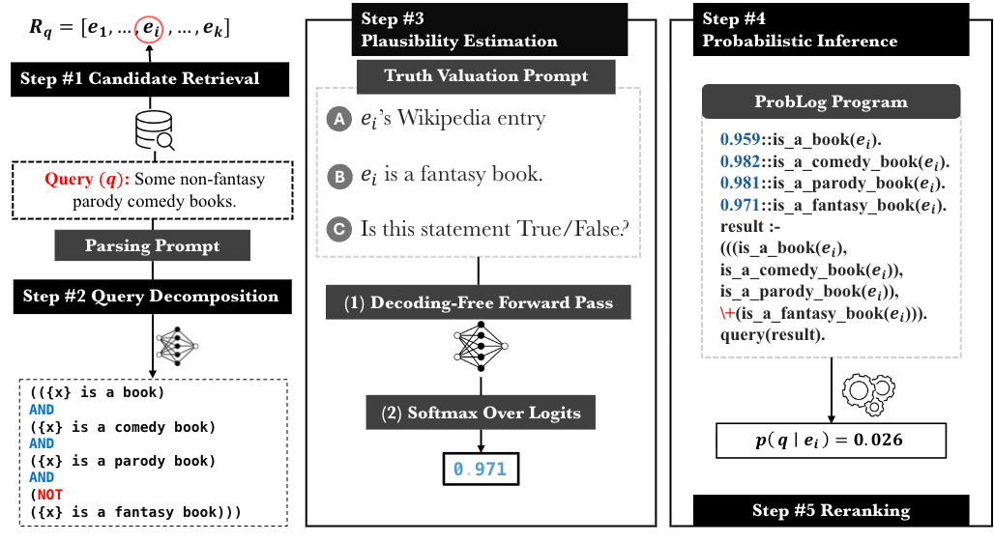
OrLog
Notes:
Closed world assumption

Slide 116
OrLog results
OrLog consistently improves top-rank results and shows its largest advantages on disjunctive structures, where the LLM treats disjunctive constraints as conjunction.
End-to-end LLM reasoning uses 6-10 times more tokens than OrLog:
(i) decoding-free predicate plausibility estimation (a single forward pass per predicate)
(ii) one-off query parsing with composition delegated to ProbLog, whose runtime and computational cost are negligible relative to an LLM call.
Mohanna Hoveyda, Jelle Piepenbrock, Arjen P. de Vries, Maarten de Rijke, and Faegheh Hasibi. 2026. OrLog: Resolving Complex Queries with LLMs and Probabilistic Reasoning. In Advances in Information Retrieval: 48th European Conference on Information Retrieval, ECIR 2026, Delft, NL. doi: 10.1007/978-3-032-21289-4_7

Slide 117
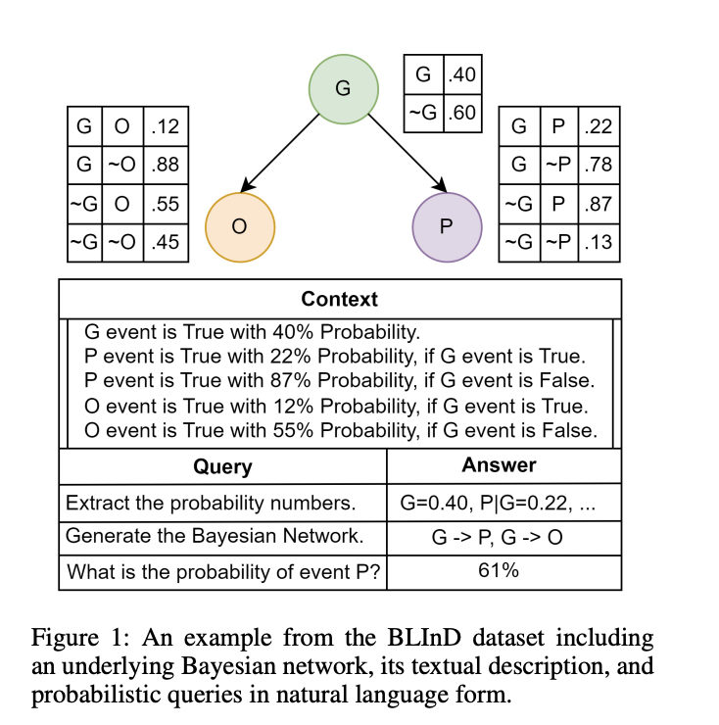
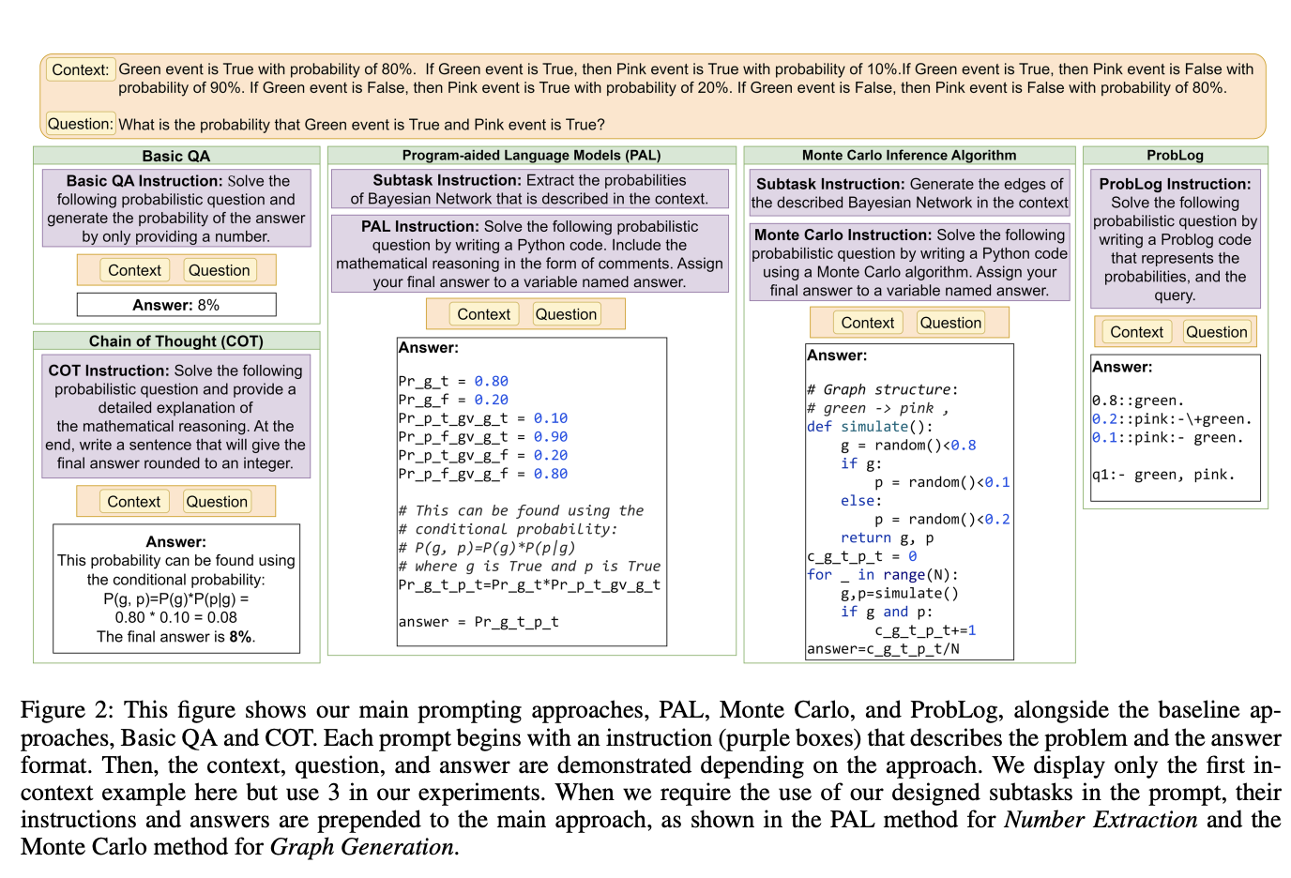
ProbLog vs LLM for Probabilistic Reasoning
Notes:
Closed world assumption

Slide 118
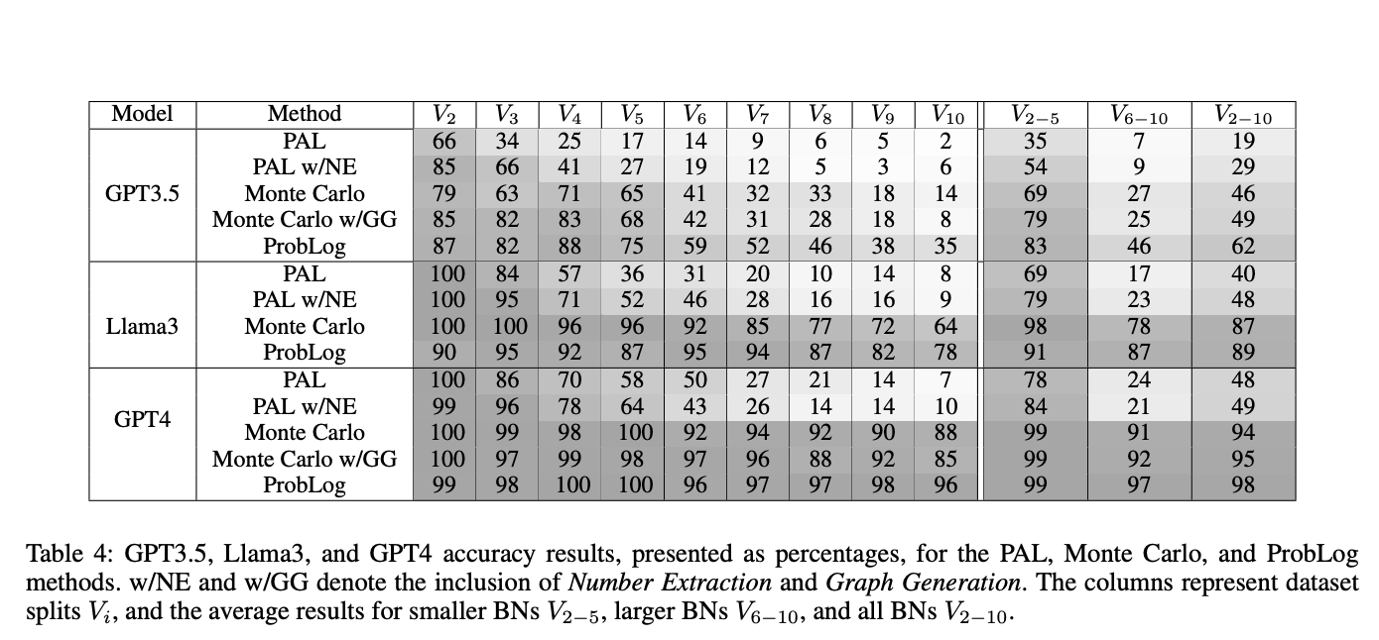
ProbLog vs LLM for Probabilistic Reasoning
Notes:
Closed world assumption

Slide 119
Wrapping up Part 4.1
Neuro-Symbolic Computing Reconciles the advantages of robust learning in neural networks and reasoning and interpretability of symbolic representation.
KGs and LLMs The amount of research that mixes knowledge graphs and large language models is tremendous, but has as yet not had a lot of impact on our field specifically.
Logic and IR The idea to apply (non-classical) logics to improve information retrieval has a long history in the field. Modelling information access symbolically may have many advantages. Will we manage to finally take up this huge challenge again?
LLMs & Probabilistic Logic Programming LLMs can turn complex questions into probabilistic logic programs and provide the probability estimates needed for a solver like ProbLog to provide the answer, more accurately and at a lower cost.

Slide 120
Reasoning Under Uncertainty
Notes:
#section: Methods (II): Non-LLM-based | 45

Slide 121
Outline
What we have seen so far
Reasoning as a multi-step inference strategy (e.g., CoT, "thinking")
Learning-to-reason on static information with grounded signals and gradient-based model updates
What this session discusses
Uncertainty as the control variable of retrieval, and search agents
Bayesian reasoning as a framework to navigate uncertainty
Act based on current “belief” and updating a model's beliefs via observation

Slide 122
Why Bayesian methods show up in LLM work
LLMs are powerful but overconfident, poorly calibrated and brittle in multi-step reasoning
The papers discussed in this section (next slide) introduce
explicit beliefs
principled updating
decision-making under uncertainty
Question: Where do we plug Bayesian methodology into the LLM training?
Notes:
STORY LINK: overconfident + poorly calibrated + brittle = the three findings of Part I restated as an uncertainty problem. The section's promise: make the uncertain object explicit, put a posterior on it, ACT on the posterior — and (new in this version) show that the same recipe is already running inside RAG and search agents.

Slide 123
Reasoning Under Uncertainty
Examples of Uncertain Objects
hypothesis support (AutoDiscovery)
reasoning uncertainty (Reasoning in Flux)
Supporting evidence in RAG
Step 1: Choose the uncertain object
Step 2: Approximate a posterior over it
Step 3: Use that posterior to act
Reasoning in Flux (Yin et al., 2024)
AutoDiscovery (Agarwal et al., 2025)

Slide 124
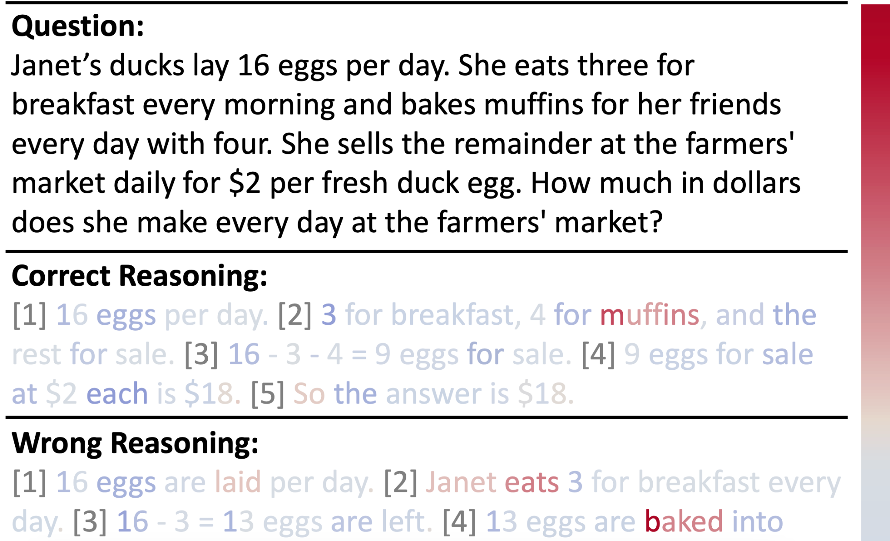
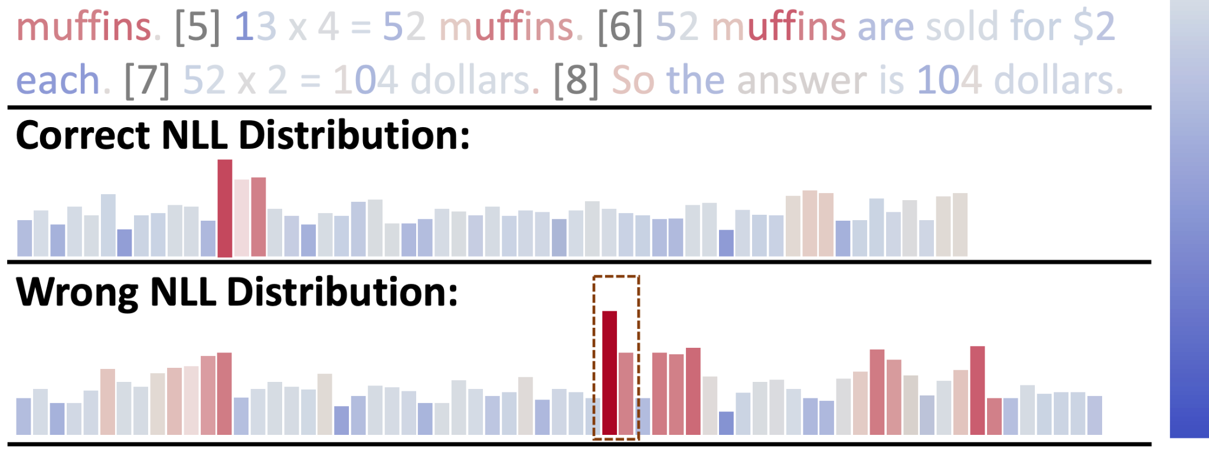
Bayes as a control signal
Reasoning in Flux (Yin et al., 2024)
Tracks token-level uncertainty during CoT
When uncertainty jumps, it backtracks
Then injects "reasoning clues" to repair the chain
Notes:
LLMs struggle with accumulating errors during complex multi-step reasoning tasks
Existing methods like Tree of Thought typically manipulate the reasoning process only after individual intermediate steps have already been generated
Phase 1: Uncertainty identification during autoregressive generation
Phase 2: Once a spike in uncertainty is detected, UAG actively intervenes by retracting the reasoning chain back to the last reliable and coherent step

Slide 125
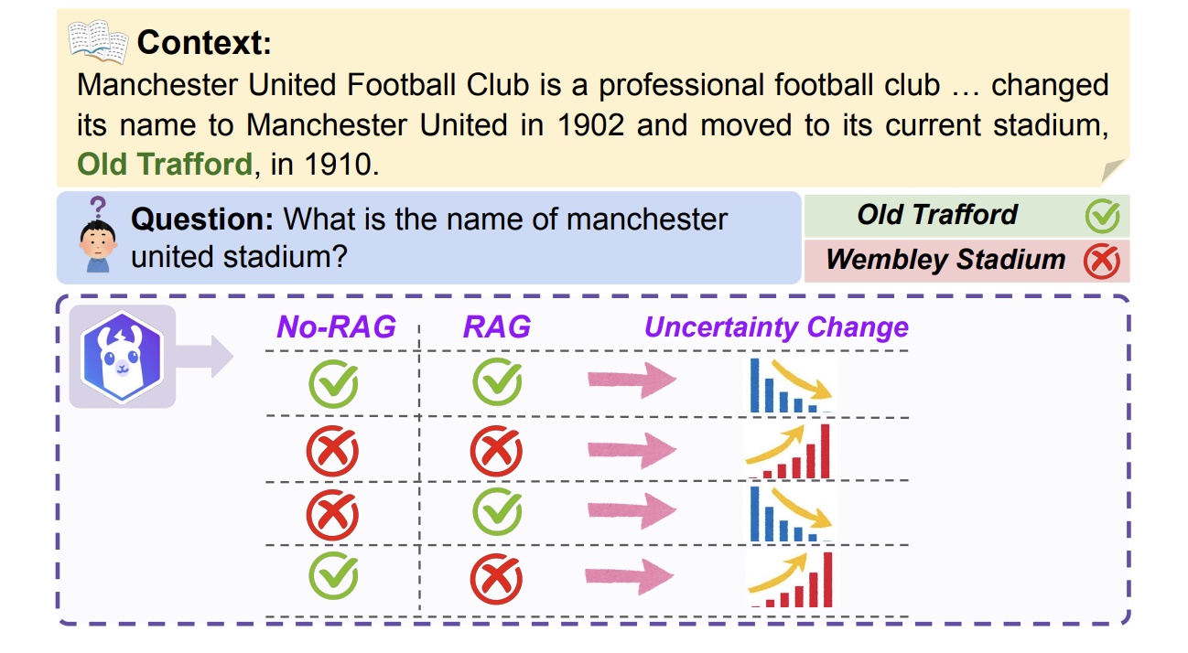
Does UQ methods generalize to RAG? (Spoiler: no)
An axiomatic analysis (Soudani, Kanoulas, Hasibi. Findings of ACL 2025)
• Five formal axioms any uncertainty estimator should satisfy once retrieved evidence enters the prompt
• No existing method satisfies them all — estimators report LOW uncertainty in RAG whether or not the context is relevant
• Simple fix: calibrate uncertainty scores with context-relevance signals
Notes:
This slide turns the section homeward to IR. The axiomatic paper is the 'naive thing fails' result: standard uncertainty estimators (entropy, verbalized confidence, sampling-consistency) were designed for closed-book generation; add retrieved evidence and they collapse — they output low uncertainty regardless of whether the retrieved context is relevant. The paper formalizes five axioms (e.g., relevant supporting context should reduce uncertainty; irrelevant context should not) and shows every existing method violates some. FRANQ makes the same point structurally: a RAG claim can be faithful-but-false (context was wrong) or unfaithful-but-true — so uncertainty must be decomposed. STORY LINK: this is Step 1 of the section's lens (choose the uncertain object) applied to RAG; axes — representational adequacy of the UNCERTAINTY representation itself.

Slide 126
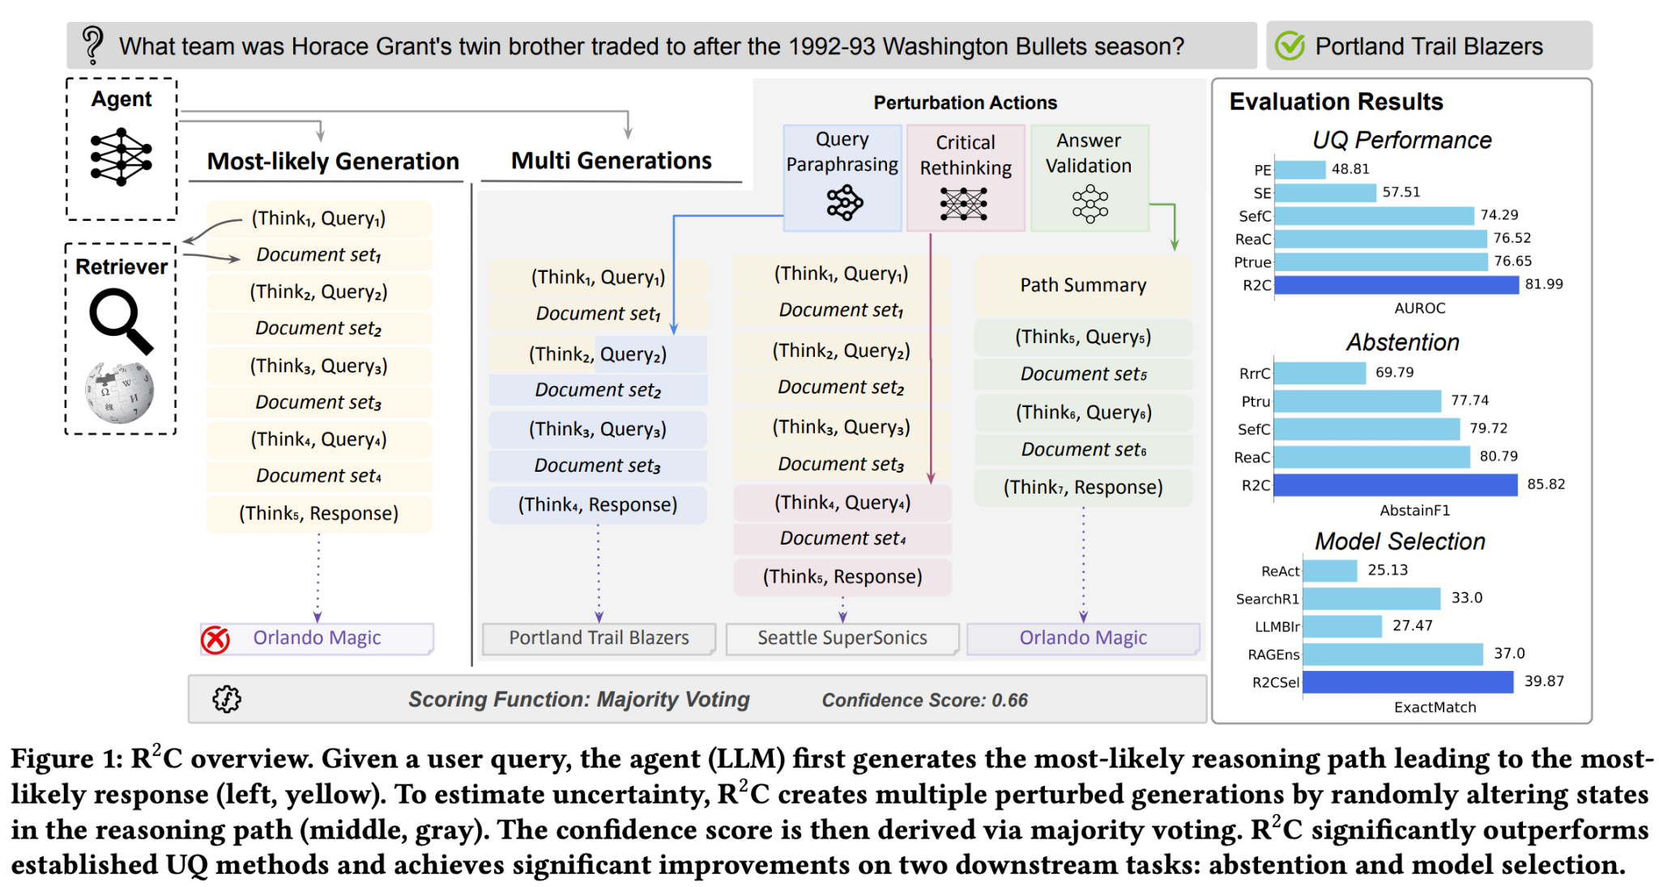
Uncertainty as the control signal of search agents
R2C: UQ for retrieval-augmented reasoning (Soudani, Zamani, Hasibi, 2025)
• Perturb intermediate reasoning steps (rewrite query, critique, re-validate) and measure outcome consistency
• >5% AUROC over strong UQ baselines; drives abstention and model selection
Step 3 of the lens, applied to IR: the posterior decides when to retrieve, when to stop, and when to abstain.
Notes:
R2C is the flagship 'IR-side' uncertainty paper: instead of scoring a single generation, it perturbs the multi-step retrieval+reasoning chain (query rewriting, answer validation, critique actions on intermediate steps) and measures how stable the outcome is — capturing uncertainty from retrieval, generation, AND their feedback loop. Then the punchline: modern RL search agents already implement 'retrieve when uncertain' implicitly — R1-Searcher++ rewards using internal knowledge when confident (~30% fewer retrievals), WebSailor explicitly frames deep search as uncertainty reduction. This section gives those heuristics their formal home. URAG is the cautionary benchmark: under retrieval noise, accuracy gains and calibration decouple; simple modular RAG often has better accuracy-uncertainty trade-offs than complex reasoning pipelines. STORY LINK: connects the Bayesian section to Part II's agentic search (Search-R1, adaptive orchestration). Axes: computational viability — knowing when NOT to retrieve/reason is a cost-control mechanism.

Slide 127
Takeaways
Reasoning under uncertainty with LLMs means
choosing what is uncertain
approximating a posterior
using it to make better decisions
The papers in this tutorial use UE methods to
explore better
predict more reliably
"repair" reasoning
update beliefs
fine-tune with calibrated uncertainty

Slide 128
Bottom line
Can Bayesian methods enhance the reasoning capabilities of LLMs?
Probably
Notes:
STORY LINK: after the IR-bridge slides, upgrade the answer verbally: 'Probably — and for IR, necessarily: retrieval under uncertainty is our field's founding problem (PRP), and agents have made it a CONTROL problem.' Then hand to Bridging.

Slide 129
5. Bridging current methods/challenges
& future directions
Notes:
#section: Future directions | 40

Slide 130
Comparative analysis of existing reasoning paradigms along key dimensions:
Representational Capability,
Inference Faithfulness,
Computational Feasibility.

Slide 131
Here again: A 12-type taxonomy, with evaluation coverage
Reasoning type | IR manifestation | Coverage
Deductive | Logical entailment between query and document | Partial
Inductive | Generalizing from retrieved evidence to claims | Partial
Abductive | Query intent inference; hypothesis formation from evidence | Untested
Analogical | Cross-domain retrieval; structural relevance beyond surface | Untested
Causal | Distinguishing correlation from intervention evidence | Untested
Defeasible | Provisional relevance; belief revision on new retrieval | Untested
Modal | Tracking claim strength (established/contested/speculative) | Untested
Epistemic | Knowledge state tracking across a literature over time | Untested
Dialectical | Mapping argumentative position within a field's disputes | Untested
Temporal | Evidence currency; supersession; historical state tracking | Partial
Metacognitive | Query reformulation; knowing when to stop; uncertainty flag | Partial
Practical | Search strategy decisions in agentic pipelines | Untested

Slide 132
How do the discussed methods compare?
Representational capability
E.g., Does reasoning proposals explicitly encode uncertainty, causal relationships, etc.?
Representational capability
Inference faithfulness
Can faithfulness of the reasoning process be verified?
Computational feasibility for IR
Is the reasoning process computationally feasible over a large set of documents?
Inference faithfulness
Computational feasibility for IR

Slide 133
Where would you place the methods?
Representational capability
E.g., Does reasoning proposals explicitly encode uncertainty, causal relationships, etc.?
Inference faithfulness
Can faithfulness of the reasoning process be verified?
Computational feasibility for IR
Is the reasoning process computationally feasible over a large set of documents?
Representational capability
Inference-time reasoning with LLMs
RL-training LLMs for reasoning
Neuro-
symbolic
Bayesian Reasoning
Enhancing the representation space
Enhancing training data
Inference faithfulness
Computational feasibility for IR

Slide 134
Our reading: the trade-off map
Method family | Representational capability | Inference faithfulness | Computational feasibility
Inference-time LLM reasoning (CoT, ToT, ReAct) | ○ implicit; no explicit logic or uncertainty | ○ traces exist but can be unfaithful | ◐ pay per query, grows with chain length
RL-trained LRMs & search agents (Search-R1, Rank-R1) | ○ implicit | ◐ sharper but narrower (pass@k); mainly outcome-only reward | ◐ heavy training, inference cost varied
Multi-agent (-component) systems | ◐ specialized roles, richer decomposition | ○ distributed trace — harder to verify | ○ coordination & token overhead
Neuro-symbolic (e.g. OrLog) | ● explicit logic + probabilities | ◐ solver steps are auditable | ◐ cheap solver; but LLM parses & scoring still expensive
Bayesian / probabilistic (this section) | ● explicit, calibrated uncertainty | ◐ posterior is inspectable | ◐ Varied. Can be costly in sampling methods.
Enhanced representations (LogiCoL, ReasonIR) | ◐ set logic / reasoning trained into vectors | ○ Performance and generalizability debatable | ● dot-product retrieval at corpus scale
● strong ◐ partial ○ weak (our synthesis: argue with us, that's the point of this slide)
Notes:
Present AFTER the audience-placement exercise, as 'our answer key'. Walk one column at a time, not row by row. Representational capability: only the symbolic and Bayesian families ENCODE logic/uncertainty explicitly; trained retrievers get partial credit because LogiCoL/ReasonIR bake structure into vectors but can't inspect it. Inference faithfulness: neuro-symbolic wins — a ProbLog/FOL derivation IS the explanation (OrLog); LLM traces are unfaithful (Chen et al. 2025, Part I); multi-agent is worst — trace is scattered across agents (slide 'Why do multi-agent systems fail?'). Computational feasibility: representations win — all reasoning is amortized into training so query time stays a dot product; inference-time LLM reasoning pays per query; multi-agent pays coordination overhead. The diagonal structure is the story: NO ROW IS ALL-GREEN. That's the punchline slide next. STORY LINK: this is the payoff of the three axes introduced in Part I — every method section of the day now sits in one comparable frame.

Slide 135
No paradigm wins all three axes nor the 12 types taxonomy.
LLMs: Generalizable, difficult to verify reasoning traces.
Neuro-Symbolic methods: better reasoning guarantees but very low generalizability.
Bayesian methods: can potentially alleviate calibration.
Enhanced representations; easy to scale, but difficult to achieve high performance with retrievers alone.
Verification Current deployed system can not certify their reasoning trace. What would a TREC-style track for inference faithfulness measure?
Performance vs cost BRIGHT went 18 → 30 → ~67 nDCG@10 in two years, mostly by spending more test-time compute. When is a reasoning-intensive query worth its token bill? (adaptive escalation, retrieve-when-uncertain)
Coverage Abduction, defeasible and dialectical reasoning — the taxonomy rows IR never tests. How can we build such benchmarks?
The bitter-lesson question Will trained retrievers simply absorb reasoning into the representation, making explicit structure unnecessary? or is structure exactly what scaling can't achieve?
Multi-aspect benchmarks Not just correctness of final answer but other aspects, e.g., cost, reasoning faithfulness, various reasoning types, generalizability.
Notes:
Discussion openers, one per axis + two meta-questions. Pick 2-3 depending on remaining time; the bitter-lesson question reliably starts an argument — use it last. Numbers behind the viability bullet: BRIGHT nDCG@10 — SFR-Embedding ~18 (2024) → ReasonIR 24.4/29.9 (2025) → leaderboard mid-2026: DIVER-v3 46.8, LATTICE ~46-49, and top entries Mira 66.9 / INF-X 63.4 (leaderboard-only, unpublished — say so if citing). STORY LINK: each question is one of the three axes left open + taxonomy coverage + the field-level question; they mirror the 'three open questions' of Part I's normative-gap slide, now informed by the whole day.

Slide 136
References
Notes:
#section: Future directions | 45

Slide 137
Section 2
Alhamoud, K. et al., 2025. NegBench: Vision-language models do not understand negation. CVPR.
Bender, E., et al. 2021. On the Dangers of Stochastic Parrots: Can Language Models Be Too Big? FAccT.
Chen et al., 2025. Reasoning Models Don't Always Say What They Think. arXiv.
Chen, Z., et al., 2025. Browsecomp-plus: A more fair and transparent evaluation benchmark of deep-research agent. arXiv.
DeepSeek, 2025. DeepSeek-R1: Incentivizing Reasoning Capability in LLMs via Reinforcement Learning. arXiv.
Dziri, N., et al., 2023. Faith and Fate: Limits of Transformers on Compositionality. NeurIPS.
Fodor, J., 2025. Line Goes Up? Inherent Limitations of Benchmarks for Evaluating Large Language Models. arXiv.
Kalai, A.T., et al., 2025. Why language models hallucinate. arXiv.
Lightman, et al., 2023. Let's Verify Step by Step. ICLR.
Liu, et al. 2024. Lost in the Middle: How Language Models Use Long Contexts. TACL
Madabushi H., et al., 2025. Neither Stochastic Parroting nor AGI: LLMs Solve Tasks through Context-Directed Extrapolation from Training Data Priors.
Malaviya, C., et al., 2023. Quest: A retrieval dataset of entity-seeking queries with implicit set operations. ACL.
Mirzadeh, et al., 2025. GSM-Symbolic: Understanding the Limitations of Mathematical Reasoning in Large Language Models. ICLR.
OpenAI 2024. Learning to Reason with LLMs. (OpenAI o1 system card)
Petcu, R., et al., 2025. A comprehensive taxonomy of negation for NLP and neural retrievers. Findings of EMNLP.
Ravichandat, A., et al., 2022. CONDAQA: A contrastive reading comprehension dataset for reasoning about negation. EMNLP.
Schaeffer et al., 2023. Are Emergent Abilities of Large Language Models a Mirage. NeurIPS.
Shi F., et al., 2023. Large Language Models Can be Easily Distracted by Irrelevant Context. ICML.
Su, H.,et al., 2025. BRIGHT: A realistic and challenging benchmark for reasoning-intensive retrieval. ICLR.
van den Elsen, C., et al., 2025. Reproducing NevIR: Negation in neural information retrieval. SIGIR.
Wang et al., 2023. Self-Consistency Improves Chain of Thought Reasoning in Language Models. ICLR.
Wang, X., et al., 2024. BIRCO: A benchmark of information retrieval tasks with complex objectives. arXiv.
Wei et al., 2022. Chain-of-Thought Prompting Elicits Reasoning in Large Language Models. NeurIPS.
Weller, O., et al., 2024. NevIR: Negation in neural information retrieval. EACL.
Weller, O., et al., 2025. FollowIR: Evaluating and teaching information retrieval models to follow instructions. NAACL.
Weller, O., et al., 2026. On the theoretical limitations of embedding-based retrieval. ICLR.
Yao et al., 2023. Tree of Thoughts: Deliberate Problem Solving with Large Language Models. NeurIPS.
Zhang, H., et al., 2024. A Careful Examination of Large Language Model Performance on Grade School Arithmetic (GSM1K). arXiv.
Zhang, W., et al., 2024. ExcluIR: Exclusionary neural information retrieval. AAAI.
Zhou et al., 2023. Least-to-Most Prompting Enables Complex Reasoning in Large Language Models. ICLR.

Slide 138
Section 3
Merrill & Sabharwal. The Parallelism Tradeoff: Limitations of Log-Precision Transformers. TACL 2023.
Feng et al. Towards Revealing the Mystery behind Chain of Thought: A Theoretical Perspective. NeurIPS 2023.
Wei et al. Chain-of-Thought Prompting Elicits Reasoning in Large Language Models. NIPS 2022.
Ruis et al. Procedural Knowledge in Pretraining Drives Reasoning in Large Language Models. ICLR 2025.
Wang & Zhou. Chain-of-Thought Reasoning without Prompting. NeurIPS 2024.
Madaan, et al. Self-refine: Iterative refinement with self-feedback. NeurIPS 2023.
Yao et al. React: Synergizing reasoning and acting in language models. ICLR 2023.
Hoveyda et al., Adaptive Orchestration of Modular Generative Information Access Systems. SIGIR 2025.
Training language models to follow instructions with human feedback. Ouyang et al., NeurIPS 2022.
DeepSeekMath: Pushing the Limits of Mathematical Reasoning in Open Language Models. Shao et al., 2024.
DeepSeek-R1 incentivizes reasoning in LLMs through reinforcement learning. Guo et al., 2025.
Search-R1: Training LLMs to Reason and Leverage Search Engines with Reinforcement Learning. Jin et al., COLM 2025.
Rank-R1: Enhancing Reasoning in LLM-based Document Rerankers via Reinforcement Learning. Zhuang et al., 2025.
Does Reinforcement Learning Really Incentivize Reasoning Capacity in LLMs Beyond the Base Model? Yue et al., NeurIPS 2025.
GPTSwarm: Language Agents as Optimizable Graphs. Zhuge et al., ICML 2024.
Adaptive Orchestration of Modular Generative Information Access Systems. Hoveyda et al., SIGIR 2025.
Multi-agent Architecture Search via Agentic Supernet. Zhang et al., ICML 2025.
Why Do Multi-Agent LLM Systems Fail? Cemri et al., 2025.

Slide 139
Section 4
Neuro-Symbolic:
A. d'Avila Garcez et al., “Neural-Symbolic Computing: An Effective Methodology for Principled Integration of Machine Learning and Reasoning”, FLAP 6(4): 611-632 (2019)
L.G. Valiant, “Three problems in computer science.” J. ACM, 50(1):96–99, 2003.
Pan et al., “Unifying Large Language Models and Knowledge Graphs: A Roadmap”, IEEE TKDE 36(7):3580-3599, 2024.
C.J. van Rijsbergen, “A new theoretical framework for information retrieval”, in SIGIR ‘86.
C.J. van Rijsbergen, “A non-classical logic for information retrieval”, The Computer Journal, 29(6):481-485, 1986.
C.J. van Rijsbergen, “Towards an information logic”, in SIGIR ‘89.
Y. Chiaramella and J.P. Chevallet, “About Retrieval Models and Logic”, The Computer Journal, 35(3), 1992.
T.W.C. Huibers, M. Lalmas and C.J. van Rijsbergen, “Information Retrieval and Situation Theory”, SIGIR Forum 30(1):11-25, 1996.
N. Fuhr, “Probabilistic datalog: Implementing logical information retrieval for advanced applications”, J. Am. Soc. Inf. Sci., 51: 95-110, 2000.
S. Mizzaro, “How many relevances in information retrieval?”, Interacting with Computers, 10(3):303-320, 1998.
Ruthven, Lalmas, and Van Rijsbergen, “Empirical investigations on query modification using abductive explanations”, in SIGIR '01.
Olausson et al., “ LINC: A neuro-symbolic approach for logical reasoning by combining language models with first-order logic provers”, in EMNLP 2023.
Hoveyda et al., “OrLog: Resolving Complex Queries with LLMs and Probabilistic Reasoning”, in ECIR 2026.
Nafar et al., “Reasoning over Uncertain Text by Generative Large Language Models”, in AAAI 2025.
R.W. White, “Advancing the Search Frontier with AI Agents”. Commun. ACM 67(9):54–65, 2024.

Slide 140
Section 4
Bayesian:
Hoffman et al., "Training Chain-of-Thought via Latent-Variable Inference", NeurIPS 2023
Tonolini et al., "Bayesian Prompt Ensembles: Model Uncertainty Estimation for Black-Box Large Language Models", Findings of ACL 2024
Yin et al., "Reasoning in Flux: Enhancing Large Language Models Reasoning through Uncertainty-aware Adaptive Guidance", ACL 2024
Wang et al., "BLoB: Bayesian Low-Rank Adaptation by Backpropagation for Large Language Models", NeurIPS 2024
Agarwal et al., "AutoDiscovery: Open-ended Scientific Discovery via Bayesian Surprise", NeurIPS 2025
Feng et al., "BIRD: A Trustworthy Bayesian Inference Framework for Large Language Models", ICLR 2025
Qiu et al., "Bayesian teaching enables probabilistic reasoning in large language models", Nature Comms 2026
Remaining:
LogiCoL: Logically-Informed Contrastive Learning for Set-based Dense Retrieval. Shen et al., ACL 2025.
Constructing Set-Compositional and Negated Representations for First-Stage Ranking. Krasakis et al., CIKM 2025.
ReasonIR: Training Retrievers for Reasoning Tasks. Shao et al., 2025.

